Slide 1





Supervised & Unsupervised Encoding Schemes of Binary Variables for Prediction Performance Enhancement
Institute of Industrial Engineering, NTU
Yun-Hao Yang, Jakey Blue
Notes:
各位口試委員、教授、同學們好，我是台大工業工程研究所的研究生 楊雲皓
很開心也很榮幸能與在座的分享我與藍俊宏老師的研究題目－針對二元特徵資料的監督式與非監督式編碼框架，亦在提升機器學習模型預測準確度

Slide 2

Overview
Motivation
Methodology
Case study
Conclusion & Future work
Notes:
在接下來的半小時中，會依序簡述本研究的發想與動機
接著詳細闡明本研究所發展規劃的方法
而後由三種不同的資料集驗證本方法的可行性
最後歸納總結本研究結果，和未來整體實驗規劃方向

Slide 3
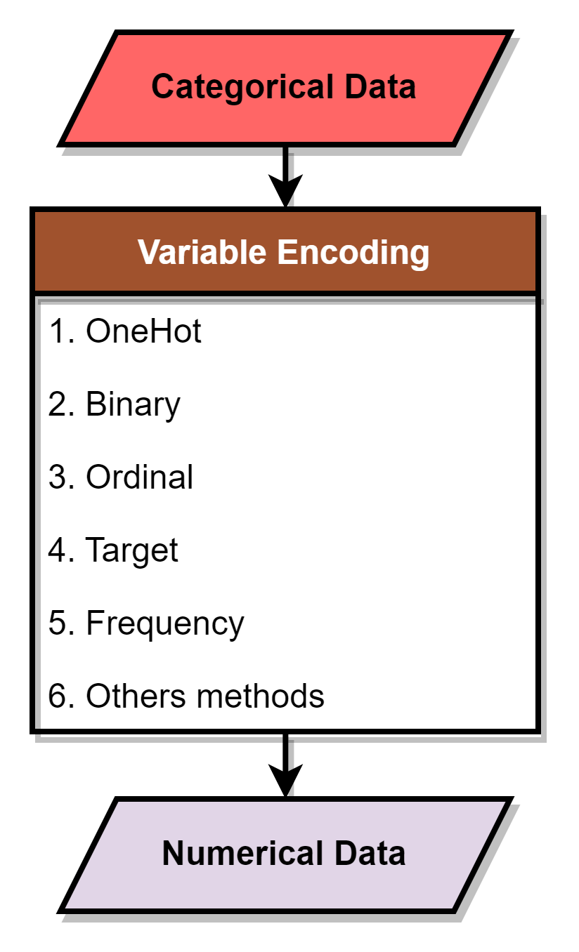
Motivation
Shape
■
▲
●
Variable Encoding
Most of the Machine learning algorithms can not handle categorical variables, unless they are encoded into numerical values.
Categorical |  | Numerical
City |  | Ordinal | Binary |  | OneHot |  |  |  | Frequency
Taipei
 |  | 0 | 0 | 0 | 0 | 0 | 0 | 1 | 0.2
New York
 |  | 1 | 0 | 1 | 0 | 0 | 1 | 0 | 0.2
London
 |  | 2 | 1 | 0 | 0 | 1 | 0 | 0 | 0.2
Tokyo
 |  | 3 | 1 | 1 | 1 | 0 | 0 | 0 | 0.2
Tokyo
 |  | 3 | 1 | 1 | 1 | 0 | 0 | 0 | 0.4
ENCODER
■ | ▲ | ●
0 | 0 | 1
0 | 1 | 0
1 | 0 | 0
Notes:
當在訓練機器學習模型時，資料的預處理是個重要的步驟，
於此進行資料清理、整合與型別轉換，以滿足模型對於輸入要求
而大多數模型通常無法處理資料當中，由字串組成的類別變數特徵
除非將這些類別特徵篩除，或改以數值的型別呈現

Slide 4
Motivation
Variable Encoding
By the different variable encoding methods, categorical variables can be represented as numerical numbers.
Categorical |  | Numerical
City |  | Ordinal | Binary |  | OneHot |  |  |  | Frequency
Taipei
 |  | 0 | 0 | 0 | 0 | 0 | 0 | 1 | 0.2
New York
 |  | 1 | 0 | 1 | 0 | 0 | 1 | 0 | 0.2
London
 |  | 2 | 1 | 0 | 0 | 1 | 0 | 0 | 0.2
Tokyo
 |  | 3 | 1 | 1 | 1 | 0 | 0 | 0 | 0.2
Tokyo
 |  | 3 | 1 | 1 | 1 | 0 | 0 | 0 | 0.4
Notes:
而變數編碼的技術便為此而生，在預處理步驟中協助轉換類別特徵成為數值特徵
目前已有相當多，且不盡相同的變數編碼方式被提出
像是耳熟能詳的Onehot encoding, Oridinal encoding 等
皆意在進行類別變數的轉換

Slide 5
Motivation
Variable Encoding
Categorical |  | Numerical
City |  | Ordinal | Binary |  | OneHot |  |  |  | Frequency
Taipei
 |  | 0 | 0 | 0 | 0 | 0 | 0 | 1 | 0.2
New York
 |  | 1 | 0 | 1 | 0 | 0 | 1 | 0 | 0.2
London
 |  | 2 | 1 | 0 | 0 | 1 | 0 | 0 | 0.2
Tokyo
 |  | 3 | 1 | 1 | 1 | 0 | 0 | 0 | 0.2
Tokyo
 |  | 3 | 1 | 1 | 1 | 0 | 0 | 0 | 0.4
Notes:
然而不同編碼方式，轉換出的新數值資料型態也不盡相同
像是binary,Onehot會轉換特徵成為二元型別、Oridinal轉換為整數、Frequency, target encoding轉換為小數等等
其中，OneHot encoding可以說是最為常見、且被廣泛使用的編碼方式了，主要因為其直觀、簡單且有效的特性
它為類別特徵當中的各個類別產生虛擬變數特徵，並產生二元型別的新資料

Slide 6
Motivation
Categorical | Animal
 | Cow
 | Tuna
 | ⁝
 | Frog
Binary | Tuna | Cat | Frog | Cod | Goat | Dog | … | Cow
 | 0 | 0 | 0 | 0 | 0 | 0 |  | 1
 | 1 | 0 | 0 | 0 | 0 | 0 |  | 0
 | ⁝ | ⁝ | ⁝ | ⁝ | ⁝ | ⁝ |  | ⁝
 | 0 | 0 | 1 | 0 | 0 | 0 |  | 1
OneHot Encoding
Notes:
但是，onehot encoding也有其缺陷，其產生出的二元特徵個數將隨著原先類別變數中的種類而變化

Slide 7
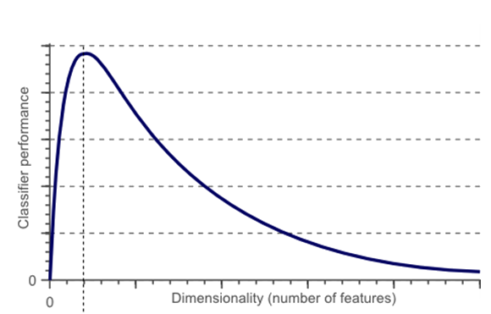
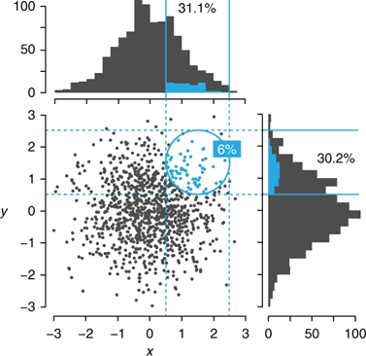
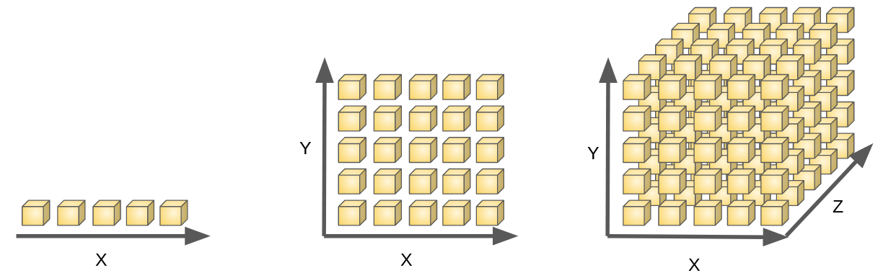
Motivation
Categorical | Animal
 | Cow
 | Tuna
 | ⁝
 | Frog
Binary | Tuna | Cat | Frog | Cod | Goat | Dog | … | Cow
 | 0 | 0 | 0 | 0 | 0 | 0 |  | 1
 | 1 | 0 | 0 | 0 | 0 | 0 |  | 0
 | ⁝ | ⁝ | ⁝ | ⁝ | ⁝ | ⁝ |  | ⁝
 | 0 | 0 | 1 | 0 | 0 | 0 |  | 1
OneHot Encoding
This causes a curse of dimensionality, hence creating the problem of parallelism and multicollinearity.
Notes:
當類別變數中的種類過多時，將會大幅度的增加總體資料的特徵總數
而特徵的增加乍聽之下是一件好事，可以讓模型有更多的評判標準
但當特徵個數增加到一定的數量之後，原先單一類別特徵的資訊被稀釋到了眾多的二元特徵之中
資料也提升至了更高的維度，如此將造成多重共線性、並行性、以及高維度空間下訓練樣本不足等問題
並打破機器學習模型基於統計學上對於樣本分布的假設、甚至難以有效計算樣本之間的歐式距離
最終使模型難以對訓練樣本作出有效歸納，導致模型表現的下滑

Slide 8
Motivation
Categorical | Animal | Size | Color
 | Cow | Big | White
 | Tuna | Med | Black
 | ⁝ | ⁝ | ⁝
 | Frog | Tiny | Green
Other Encoding
Numerical | Animal | Size | Color
 | 10 | 4 | 7
 | 2 | 3 | 6
 | ⁝ | ⁝ | ⁝
 | 7 | 1 | 3
One Hot
Binary | Animal |  |  |  |  |  |  |  | Size |  |  |  | Color
 | Tuna | Cat | Frog | Cod | Goat | Dog | Toad | Cow | Large | Mid | Small | Tiny | White | Black | Red | Blue | Green | Gray
 | 0 | 0 | 0 | 0 | 0 | 0 | 0 | 1 | 1 | 0 | 0 | 0 | 1 | 0 | 0 | 0 | 0 | 0
 | 1 | 0 | 0 | 0 | 0 | 0 | 0 | 0 | 0 | 1 | 0 | 0 | 0 | 1 | 0 | 0 | 0 | 0
 | ⁝ | ⁝ | ⁝ | ⁝ | ⁝ | ⁝ | ⁝ | ⁝ | ⁝ | ⁝ | ⁝ | ⁝ | ⁝ | ⁝ | ⁝ | ⁝ | ⁝ | ⁝
 | 0 | 0 | 1 | 0 | 0 | 0 | 0 | 1 | 0 | 0 | 0 | 1 | 0 | 0 | 0 | 0 | 1 | 0
Notes:
避免以上狀況發生的最好方式便是，當遭遇具有多種類的類別特徵時，
便不要使用onehot encoding，而改用其他的編碼方式，像是ordinal, target, encoding固定特徵個數方法等
如此一來便能避免上述的問題發生
在此圖中可以看到，onehot, binary encoding將類別資料轉變為二元資料，
而傳統的編碼方式則將類別資料轉變為數值資料

Slide 9
Motivation
Categorical | Animal | Size | Color
 | Cow | Big | White
 | Tuna | Med | Black
 | ⁝ | ⁝ | ⁝
 | Frog | Tiny | Green
Other Encoding
Numerical | Animal | Size | Color
 | 10 | 4 | 7
 | 2 | 3 | 6
 | ⁝ | ⁝ | ⁝
 | 7 | 1 | 3
Binary
 | Tuna | Cat | Frog | Cod | Goat | Dog | Toad | Cow | Large | Mid | Small | Tiny | White | Black | Red | Blue | Green | Gray
 | 0 | 0 | 0 | 0 | 0 | 0 | 0 | 1 | 1 | 0 | 0 | 0 | 1 | 0 | 0 | 0 | 0 | 0
 | 1 | 0 | 0 | 0 | 0 | 0 | 0 | 0 | 0 | 1 | 0 | 0 | 0 | 1 | 0 | 0 | 0 | 0
 | ⁝ | ⁝ | ⁝ | ⁝ | ⁝ | ⁝ | ⁝ | ⁝ | ⁝ | ⁝ | ⁝ | ⁝ | ⁝ | ⁝ | ⁝ | ⁝ | ⁝ | ⁝
 | 0 | 0 | 1 | 0 | 0 | 0 | 0 | 1 | 0 | 0 | 0 | 1 | 0 | 0 | 0 | 0 | 1 | 0
Notes:
但，如果今天的第一手資料為二元型別的高維度資料呢？
且如果該資料不符合onehot encoding原則，缺乏二元特徵之間的群組資訊
無法轉為類別資料，再經由別的變數編碼處理
同時也缺乏將二元資料轉換為數值資料的編碼方式

Slide 10


Motivation
If the data is not follow the One Hot rule, can’t use other method to transform the binary data.
Numerical | Group 1 | Group 2 | Group 3
 | 10 | 4 | 7
 | 2 | 3 | 6
 | ⁝ | ⁝ | ⁝
 | 7 | 1 | 3
Binary | Tuna | Cat | Frog | Cod | Goat | Dog | Toad | Cow | Large | Mid | Small | Tiny | White | Black | Red | Blue | Green | Gray
 | 0 | 0 | 0 | 0 | 0 | 0 | 0 | 1 | 1 | 0 | 0 | 0 | 1 | 0 | 0 | 0 | 0 | 0
 | 1 | 0 | 0 | 0 | 0 | 0 | 0 | 0 | 0 | 1 | 0 | 0 | 0 | 1 | 0 | 0 | 0 | 0
 | ⁝ | ⁝ | ⁝ | ⁝ | ⁝ | ⁝ | ⁝ | ⁝ | ⁝ | ⁝ | ⁝ | ⁝ | ⁝ | ⁝ | ⁝ | ⁝ | ⁝ | ⁝
 | 0 | 0 | 1 | 0 | 0 | 0 | 0 | 1 | 0 | 0 | 0 | 1 | 0 | 0 | 0 | 0 | 1 | 0
Notes:
而如何編碼二元資料為數值資料，即為本研究的主旨
發展針對二元資料的編碼方式，協助高維度二元資料轉換為數值資料
而在降低維度的同時，維持新資料對於模型的分類、或是回歸表現
以上便是本研究的發想過程與動機

Slide 11
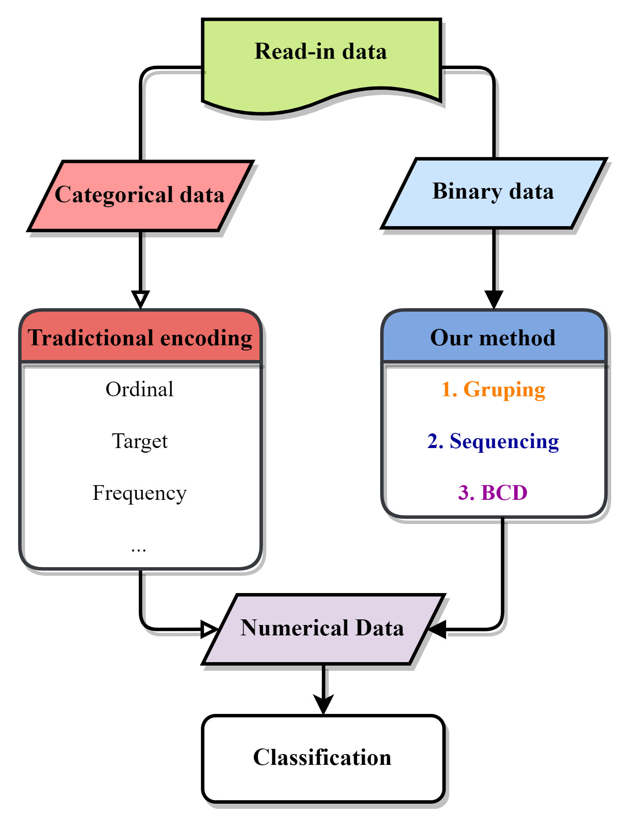
Methodology
Col 6 | Col 2 | Col 5 | Col 4 | Col 1 | Col 3
0 | 1 | 0 | 1 | 1 | 0
0 | 0 | 1 | 1 | 1 | 0
⁝ | ⁝ | ⁝ | ⁝ | ⁝ | ⁝
1 | 0 | 1 | 0 | 0 | 1
Notes:
在研究動機中，我們提及了傳統變數編碼僅針對類別資料做轉換
相比於此，本研究設法開發針對二元資料的編碼方式
As the traditional encoding is only for categorical part. In the research, we try to develop a variable encoding method built for binary data, which is able to transform non-grouped binary into numerical, within these 3 steps: column Grouping, Sequencing, and binary-coded decimal. The following animation will show how these steps works.

Slide 12
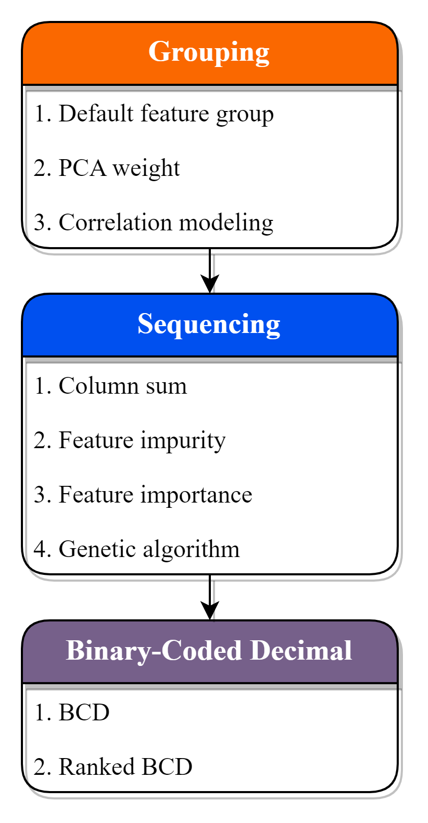
Methodology
Notes:
依序透過群組、排序以及Binary-coded decimal，簡稱為BCD碼的方式
將高維度二元資料轉換為特定維度的數值資料
可以見到不同步驟底下有著各不相同的方式，乃是截止目前本研究所提出、嘗試的方法
像在群組方法中，便嘗試了根據PCA權重、或相關係數模型的方式來進行群組
也可以在後續研究之中試驗新的方法
As the traditional encoding is only for categorical part. In the research, we try to develop a variable encoding method built for binary data, which is able to transform non-grouped binary into numerical, within these 3 steps: column Grouping, Sequencing, and binary-coded decimal. The following animation will show how these steps works.

Slide 13
Methodology
Group
Sequence
BCD
Col 1 | Col 2 | Col 3 | Col 4 | Col 5 | Col 6
1 | 1 | 0 | 1 | 0 | 0
1 | 0 | 0 | 1 | 1 | 0
⁝ | ⁝ | ⁝ | ⁝ | ⁝ | ⁝
0 | 0 | 1 | 0 | 1 | 1
In the research, we propose a method to encode binary data in to numerical data. Via grouping, sequencing and transforming the binary row data with BCD encode.
Grouping similar, correlated features
Sequencing features in each feature group
BCD encode on each feature group
Tiny | Cat | Large | Black | White | Cow
1 | 1 | 0 | 1 | 0 | 0
0 | 0 | 1 | 0 | 1 | 1
⁝ | ⁝ | ⁝ | ⁝ | ⁝ | ⁝
0 | 0 | 1 | 0 | 1 | 1
Notes:
以下將由動畫的方式簡單帶過整個編碼流程
假設以此六維度的二元資料作為方法輸入
資料中有2個動物特徵、2個尺寸特徵、及兩個顏色特徵，但輸入並無提供此特徵與特徵之間具有的關聯關係

Slide 14
Methodology
Group
Sequence
BCD
In the research, we propose a method to encode binary data in to numerical data. Via grouping, sequencing and transforming the binary row data with BCD encode.
Grouping similar, correlated features
Sequencing features in each feature group
BCD encode on each feature group
Tiny
1
0
⁝
0
Cat
1
0
⁝
0
Large
0
1
⁝
1
Black
1
0
⁝
0
White
0
1
⁝
1
Cow
0
1
⁝
1
Notes:
第一步便是群組，目標即為找出此類的關聯關係
並將相互關聯、或相似的特徵，規納入同一群組之中
In grouping phase, hoping by the feature selection method can find this kind of relationship.
In this case, we successfully group the columns by their physical meaning, which is animal types, colors, and sizes.

Slide 15
Methodology
Group
Sequence
BCD
In the research, we propose a method to encode binary data in to numerical data. Via grouping, sequencing and transforming the binary row data with BCD encode.
Grouping similar, correlated features
Sequencing features in each feature group
BCD encode on each feature group
Cat
1
0
⁝
0
Cow
0
1
⁝
1
Black
1
0
⁝
0
White
0
1
⁝
1
Tiny
1
0
⁝
0
Large
0
1
⁝
1
Notes:
第二步為排序，在各群組內部調動組內特徵
此步驟的目視為了產生出更加有競爭力、有助於分類或回歸任務的數值特徵
詳細的方法與原理將在後續提及
Secondly in the sequencing phase, for generating a more competitive numerical value, we need to rearrange the sequence of columns in groups. The detail and the reason why will be explained later on

Slide 16
Methodology
Group
Sequence
BCD
In the research, we propose a method to encode binary data in to numerical data. Via grouping, sequencing and transforming the binary row data with BCD encode.
Grouping similar, correlated features
Sequencing features in each feature group
BCD encode on each feature group
Cow | Cat | White | Black | Tiny | Large
0 | 1 | 0 | 1 | 1 | 0
1 | 0 | 1 | 0 | 0 | 1
⁝ | ⁝ | ⁝ | ⁝ | ⁝ | ⁝
1 | 0 | 1 | 0 | 0 | 1

Slide 17
Methodology
Group
Sequence
BCD
In the research, we propose a method to encode binary data in to numerical data. Via grouping, sequencing and transforming the binary row data with BCD encode.
Grouping similar, correlated features
Sequencing features in each feature group
BCD encode on each feature group
Animal | Color | Size
1 | 1 | 2
2 | 2 | 1
⁝ | ⁝ | ⁝
2 | 2 | 1
Notes:
最後一步則是進行BCD編碼，將排序過後的組內複數二元特徵轉變為數值的形式
經由此三步驟之後，便完成了整個編碼過程
In the last step, with the binary – code decimal, we can represent columns into numerical values. And that’s it, we have generated a both understandable and tidy dataset with numerical value form the non-grouped binary data.

Slide 18
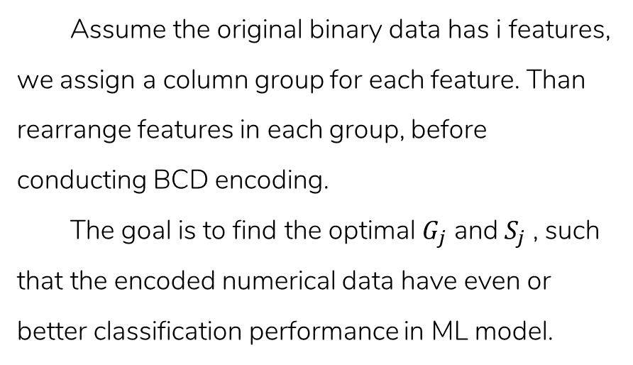
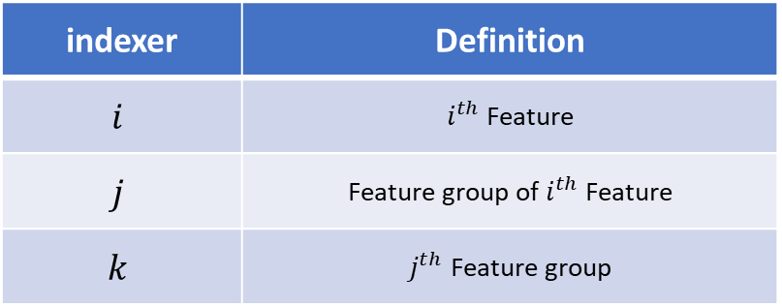
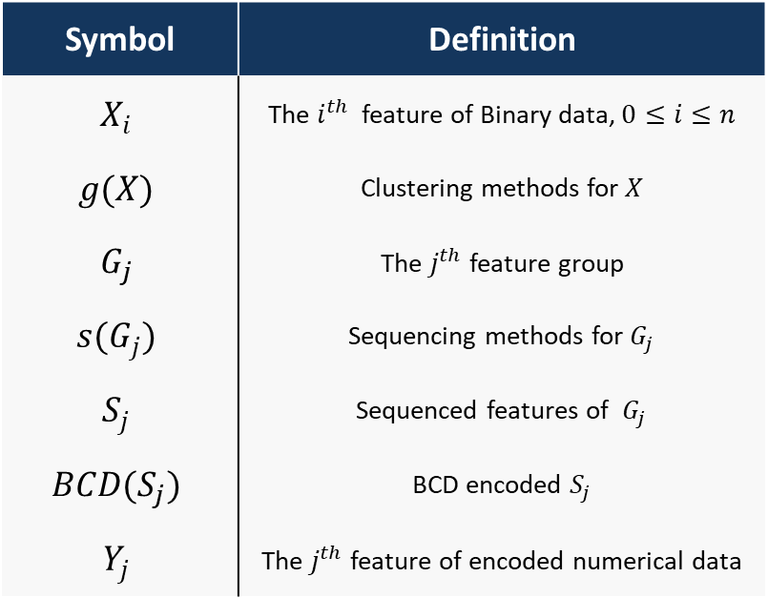
Methodology -problem definition
Assume the original binary data has i features, we assign a column group for each feature. Than rearrange features in each group, before conducting BCD encoding.
The goal is to find the optimal $G_{j}$ and $S_{j}$ , such that the encoded numerical data have even or better classification performance in ML model.
Symbol | Definition
$$X_{i}$$ | The $i^{th}$ feature of Binary data, $0≤i≤n$
$$g(X)$$ | Clustering methods for $X$
$$G_{j}$$ | The $j^{th}$ feature group
$$s(G_{j})$$ | Sequencing methods for $G_{j}$
$$S_{j}$$ | Sequenced features of $G_{j}$
$$BCD(S_{j})$$ | BCD encoded $S_{j}$
$$Y_{j}$$ | The $j^{th}$ feature of encoded numerical data
indexer | Definition
$$i$$ | $i^{th}$ Feature
$$j$$ | Feature group of $i^{th}$ Feature
$$k$$ | $j^{th}$ Feature group
Notes:
此為整體問題的符號表示與定義，可以簡略的
簡而言之，本研究著重在於尋找出最佳的群組、以及排序方式
使產生出的新數值資料在機器學習模型中有著更加的分類表現

Slide 19
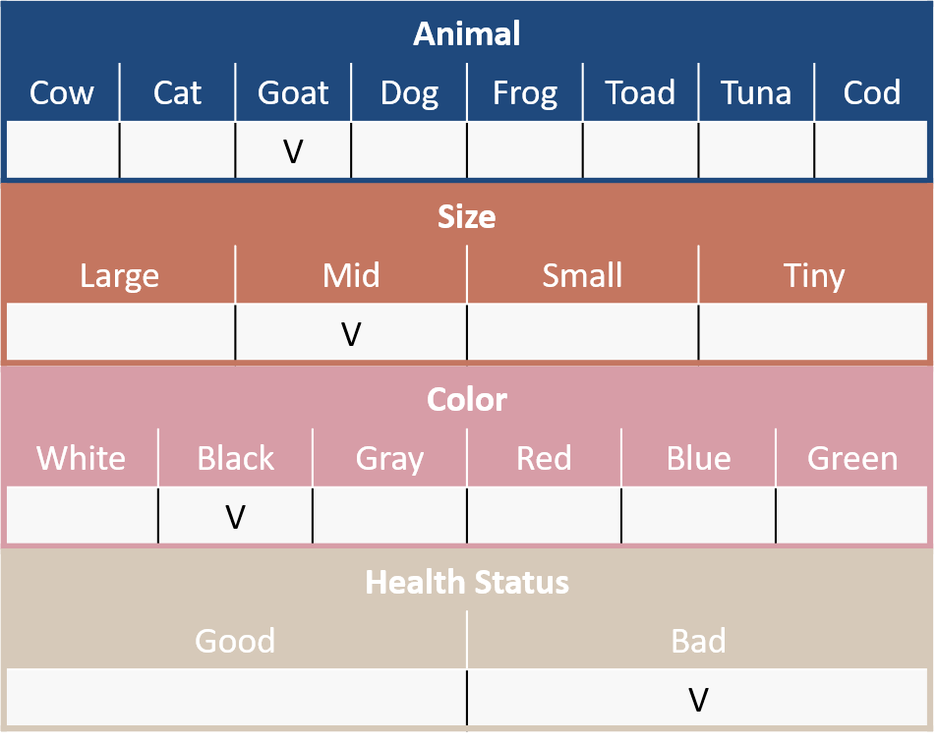
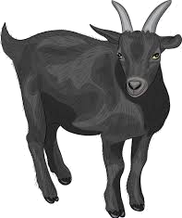



Methodology -An animal check
Animal
Cow | Cat | Goat | Dog | Frog | Toad | Tuna | Cod
 |  | V
Size
Large | Mid | Small | Tiny
 | V
Color
White | Black | Gray | Red | Blue | Green
 | V
Health Status
Good | Bad
 | V
Notes:
在此將以一個簡單的案例作為方法輸入
假設我們為動物園管理者，需要對園區中的各式生物進行健康檢測，而檢測表如此圖所示
可見其中包含了物種、尺寸、顏色以及健康狀態的欄位，且欄位中的各選項相互互斥
任務為依據物種、尺寸、顏色，對健康狀態作出預測

Slide 20
Methodology -An animal check
Binary Data (Total:300 sample, 200 good, 100 bad)
Animal
Cow | Cat | Goat | Dog | Frog | Toad | Tuna | Cod
 |  | V
Size
Large | Mid | Small | Tiny
 | V
Color
White | Black | Gray | Red | Blue | Green
 | V
Health Status
Good | Bad
 | V
Notes:
當在蒐集了300園中動物的資料後，可以得到右方的堆疊直方圖
直方圖以紅、藍兩色作為生病、與健康的標示，表示了在各個選項之中被勾選的動物數量
像是在尺寸:中等的選項中，共有接近100隻的動物，且這100隻動物中有一半50隻為健康、另一半為生病
而任務便是以這18個二元選項作為特徵，來預測動物的健康狀態

Slide 21
Methodology -An animal check
Binary Data (Total:300 sample, 200 good, 100 bad)
Animal | Cow | Cat | Goat | Dog | Frog | … | Blue | Green
#1 | 0 | 1 | 0 | 0 | 0 | … | 0 | 0
#2 | 1 | 0 | 0 | 0 | 0 | … | 0 | 0
#3 | 0 | 0 | 0 | 0 | 0 | … | 0 | 0
#4 | 0 | 0 | 0 | 0 | 0 | … | 0 | 0
#5 | 0 | 0 | 1 | 0 | 0 | … | 0 | 0
#6 | 0 | 0 | 0 | 0 | 1 | … | 0 | 0
#7 | 0 | 0 | 0 | 0 | 0 | … | 0 | 0
⁝ | ⁝ | ⁝ | ⁝ | ⁝ | ⁝ | ⁝ | ⁝ | ⁝
#300 | 0 | 0 | 0 | 1 | 0 | … | 0 | 0
Animal
Cow | Cat | Goat | Dog | Frog | Toad | Tuna | Cod
 |  | V
Size
Large | Mid | Small | Tiny
 | V
Color
White | Black | Gray | Red | Blue | Green
 | V
Health Status
Good | Bad
 | V
Notes:
將其以表格形式表達將如此表示，
300動物在這18個選項之中的勾選狀態

Slide 22
Methodology -Grouping
Group
Sequence
BCD
Binary Data (Total:300 sample, 200 good, 100 bad)
First, try to find the relationship of these binary features, then clustering those related, correlated features into same cluster.
By Default information
By PCA
By Correlation modeling
K-means
Hierarchical clustering
Block modeling
Notes:
首先，將針對這18個二元特徵進行群組，除了依照原先的欄位組群組外，
本研究已嘗試使用PCA權重、聚類模型結合相關係數的方式來完成任務
以下投影片將簡介如何以PCA, 區塊模型群組特徵

Slide 23
Methodology -PCA Grouping
Group
Sequence
BCD
No. | PC 1 |  |  | PC 2 |  |  | PC 3
 | Feature | Abs. weight | select | Feature | Abs. weight | select | Feature | Abs. weight | select
1. | Cow | 0.562 | O | Cat | 0.642 | X | Black | 0.047 | X
2. | Cat | 0.486 | O | Cow | 0.496 | X | Goat | 0.035 | X
3. | Large | 0.348 | O | Mid | 0.402 | X | Cat | 0.032 | X
4. | Mid | 0.311 | O | Black | 0.351 | X | Cow | 0.030 | X
5. | White | 0.307 | O | Goat | 0.302 | O | Mid | 0.028 | X
6. | Black | 0.202 | O | Dog | 0.229 | O | Gray | 0.023 | X
7. | Small | 0.187 | X | Large | 0.199 | X | White | 0.021 | X
8. | Goat | 0.153 | X | Frog | 0.183 | O | Dog | 0.020 | X
9. | Cod | 0.101 | X | Small | 0.152 | O | Large | 0.018 | X
10. | Tuna | 0.091 | X | Gray | 0.132 | O | Frog | 0.016 | X
11. | Dog | 0.074 | X | White | 0.105 | X | Small | 0.014 | X
12. | Gray | 0.060 | X | Red | 0.008 | O | Toad | 0.014 | O
13. | Frog | 0.056 | X | Frog | 0.008 | X | Tuna | 0.012 | O
14. | Toad | 0.032 | X | Red | 0.007 | X | Cod | 0.007 | O
15. | Red | 0.029 | X | Toad | 0.005 | X | Red | 0.005 | X
16. | Tiny | 0.023 | X | Green | 0.001 | X | Tiny | 0.002 | O
17. | Green | 0.015 | X | Tiny | 0.001 | X | Blue | 0.001 | O
18. | Blue | 0.009 | X | Blue | 0.001 | X | Green | 0.001 | O
Notes:
首先是針對PCA權重的群組方式
透過前3個主成分列舉特徵權重絕對值，並依照主成分順序依序選擇前六個特徵進入同一群組中
若預選取特徵已被前方主成分選取，則跳過並選則下一個特徵，如PC1與PC2

Slide 24
Methodology -PCA Grouping
Group
Sequence
BCD
No. | PC 1 |  |  | PC 2 |  |  | PC 3
 | Feature | Abs. weight | select | Feature | Abs. weight | select | Feature | Abs. weight | select
1. | Cow | 0.562 | O | Cat | 0.642 | X | Black | 0.047 | X
2. | Cat | 0.486 | O | Cow | 0.496 | X | Goat | 0.035 | X
3. | Large | 0.348 | O | Mid | 0.402 | X | Cat | 0.032 | X
4. | Mid | 0.311 | O | Black | 0.351 | X | Cow | 0.030 | X
5. | White | 0.307 | O | Goat | 0.302 | O | Mid | 0.028 | X
6. | Black | 0.202 | O | Dog | 0.229 | O | Gray | 0.023 | X
7. | Small | 0.187 | X | Large | 0.199 | X | White | 0.021 | X
8. | Goat | 0.153 | X | Frog | 0.183 | O | Dog | 0.020 | X
9. | Cod | 0.101 | X | Small | 0.152 | O | Large | 0.018 | X
10. | Tuna | 0.091 | X | Gray | 0.132 | O | Frog | 0.016 | X
11. | Dog | 0.074 | X | White | 0.105 | X | Small | 0.014 | X
12. | Gray | 0.060 | X | Red | 0.008 | O | Toad | 0.014 | O
13. | Frog | 0.056 | X | Frog | 0.008 | X | Tuna | 0.012 | O
14. | Toad | 0.032 | X | Red | 0.007 | X | Cod | 0.007 | O
15. | Red | 0.029 | X | Toad | 0.005 | X | Red | 0.005 | X
16. | Tiny | 0.023 | X | Green | 0.001 | X | Tiny | 0.002 | O
17. | Green | 0.015 | X | Tiny | 0.001 | X | Blue | 0.001 | O
18. | Blue | 0.009 | X | Blue | 0.001 | X | Green | 0.001 | O
Notes:
如此往復直到全部18個特徵被分為3個群組便完成了整個群組過程
此方法假設特徵間的重要度不盡相同，並依據特徵絕對值群聚重要度相近的特徵
因此較為前方的主成分將吸收更多重要、且富有分類價值的特徵，
以求在排序、編碼後，產生出更具有分類效果的數值特徵
並可根據主成分，篩選掉不重要的二元特徵

Slide 25
Methodology -Block modeling Grouping
Group
Sequence
BCD
 | Tuna | Cat | Frog | Cod | Goat | Dog | Toad | Cow | Large | Mid | Small | Tiny | White | Black | Red | Blue | Green | Gray
Tuna | 1.0 | 0.2 | 0.2 | 0.8 | 0.2 | 0.2 | 0.8 | 0.2 | 0.1 | 0.1 | 0.1 | 0.3 | 0.0 | 0.0 | 0.0 | 0.5 | 0.5 | 0.0
Cat | 0.2 | 1.0 | 0.2 | 0.2 | 0.2 | 0.2 | 0.2 | 0.8 | 0.3 | 0.3 | 0.1 | 0.1 | 0.2 | 0.2 | 0.0 | 0.0 | 0.0 | 0.0
Frog | 0.2 | 0.2 | 1.0 | 0.2 | 0.8 | 0.8 | 0.2 | 0.2 | 0.1 | 0.1 | 0.3 | 0.1 | 0.0 | 0.0 | 0.3 | 0.0 | 0.0 | 0.3
Cod | 0.8 | 0.2 | 0.2 | 1.0 | 0.2 | 0.2 | 0.8 | 0.8 | 0.1 | 0.1 | 0.1 | 0.3 | 0.0 | 0.0 | 0.0 | 0.3 | 0.3 | 0.0
Goat | 0.2 | 0.2 | 0.8 | 0.2 | 1.0 | 0.8 | 0.2 | 0.2 | 0.1 | 0.1 | 0.3 | 0.1 | 0.0 | 0.0 | 0.3 | 0.0 | 0.0 | 0.3
Dog | 0.2 | 0.2 | 0.8 | 0.2 | 0.8 | 1.0 | 0.2 | 0.2 | 0.1 | 0.1 | 0.3 | 0.1 | 0.0 | 0.0 | 0.3 | 0.0 | 0.0 | 0.3
Toad | 0.8 | 0.2 | 0.2 | 0.8 | 0.2 | 0.2 | 1.0 | 0.2 | 0.1 | 0.1 | 0.1 | 0.3 | 0.0 | 0.0 | 0.0 | 0.3 | 0.0 | 0.0
Cow | 0.2 | 0.8 | 0.2 | 0.8 | 0.2 | 0.2 | 0.2 | 1.0 | 0.3 | 0.3 | 0.1 | 0.1 | 0.3 | 0.3 | 0.0 | 0.0 | 0.0 | 0.0
Large | 0.1 | 0.3 | 0.1 | 0.1 | 0.1 | 0.1 | 0.1 | 0.3 | 1.0 | 0.5 | 0.1 | 0.1 | 0.6 | 0.6 | 0.2 | 0.2 | 0.2 | 0.2
Mid | 0.1 | 0.3 | 0.1 | 0.1 | 0.1 | 0.1 | 0.1 | 0.3 | 0.5 | 1.0 | 0.1 | 0.1 | 0.6 | 0.6 | 0.2 | 0.2 | 0.2 | 0.2
Small | 0.1 | 0.1 | 0.3 | 0.1 | 0.3 | 0.3 | 0.1 | 0.1 | 0.1 | 0.1 | 1.0 | 0.1 | 0.2 | 0.2 | 0.6 | 0.2 | 0.2 | 0.6
Tiny | 0.3 | 0.1 | 0.1 | 0.3 | 0.1 | 0.1 | 0.3 | 0.1 | 0.1 | 0.1 | 0.1 | 1.0 | 0.2 | 0.2 | 0.2 | 0.6 | 0.2 | 0.2
White | 0.0 | 0.2 | 0.0 | 0.0 | 0.0 | 0.0 | 0.0 | 0.3 | 0.6 | 0.6 | 0.2 | 0.2 | 1.0 | 0.8 | 0.4 | 0.4 | 0.4 | 0.4
Black | 0.0 | 0.2 | 0.0 | 0.0 | 0.0 | 0.0 | 0.0 | 0.3 | 0.6 | 0.6 | 0.2 | 0.2 | 0.8 | 1.0 | 0.4 | 0.4 | 0.4 | 0.8
Red | 0.0 | 0.0 | 0.3 | 0.0 | 0.3 | 0.3 | 0.0 | 0.0 | 0.2 | 0.2 | 0.6 | 0.2 | 0.4 | 0.4 | 1.0 | 0.4 | 0.4 | 0.4
Blue | 0.5 | 0.0 | 0.0 | 0.3 | 0.0 | 0.0 | 0.3 | 0.0 | 0.2 | 0.2 | 0.2 | 0.6 | 0.4 | 0.4 | 0.4 | 1.0 | 0.8 | 0.8
Green | 0.5 | 0.0 | 0.0 | 0.3 | 0.0 | 0.0 | 0.0 | 0.0 | 0.2 | 0.2 | 0.2 | 0.2 | 0.4 | 0.4 | 0.4 | 0.8 | 1.0 | 0.4
Gray | 0.0 | 0.0 | 0.3 | 0.0 | 0.3 | 0.3 | 0.0 | 0.0 | 0.2 | 0.2 | 0.6 | 0.2 | 0.4 | 0.8 | 0.4 | 0.8 | 0.4 | 1.0
Notes:
皆著是以區塊模型結合相關係數的方式
再列舉出特徵與特徵之間的相關係數圖之後，便嘗試調動特徵順序，
使整張相關係數圖區分出不同的聚類

Slide 26
Methodology -Block modeling Grouping
Group
Sequence
BCD
 | Cow | Cat | Large | Mid | White | Black | Goat | Dog | Frog | Small | Gray | Red | Toad | Tuna | Cod | Tiny | Blue | Green
Cow | 1.0 | 0.8 | 0.3 | 0.3 | 0.5 | 0.5 | 0.2 | 0.2 | 0.2 | 0.1 | 0.0 | 0.0 | 0.2 | 0.2 | 0.2 | 0.1 | 0.0 | 0.0
Cat | 0.8 | 1.0 | 0.3 | 0.3 | 0.5 | 0.5 | 0.2 | 0.2 | 0.2 | 0.1 | 0.0 | 0.0 | 0.2 | 0.2 | 0.2 | 0.1 | 0.0 | 0.0
Large | 0.3 | 0.3 | 1.0 | 0.5 | 0.6 | 0.6 | 0.1 | 0.1 | 0.1 | 0.1 | 0.2 | 0.2 | 0.1 | 0.1 | 0.1 | 0.1 | 0.2 | 0.2
Mid | 0.3 | 0.3 | 0.5 | 1.0 | 0.6 | 0.6 | 0.1 | 0.1 | 0.1 | 0.1 | 0.2 | 0.2 | 0.1 | 0.1 | 0.1 | 0.1 | 0.2 | 0.2
White | 0.5 | 0.5 | 0.6 | 0.6 | 1.0 | 0.8 | 0.0 | 0.0 | 0.0 | 0.2 | 0.4 | 0.4 | 0.0 | 0.0 | 0.0 | 0.2 | 0.4 | 0.4
Black | 0.5 | 0.5 | 0.6 | 0.6 | 0.8 | 1.0 | 0.0 | 0.0 | 0.0 | 0.2 | 0.4 | 0.4 | 0.0 | 0.0 | 0.0 | 0.2 | 0.4 | 0.4
Goat | 0.2 | 0.2 | 0.1 | 0.1 | 0.0 | 0.0 | 1.0 | 0.8 | 0.8 | 0.3 | 0.3 | 0.3 | 0.2 | 0.2 | 0.2 | 0.1 | 0.0 | 0.0
Dog | 0.2 | 0.2 | 0.1 | 0.1 | 0.0 | 0.0 | 0.8 | 1.0 | 0.8 | 0.3 | 0.5 | 0.5 | 0.2 | 0.2 | 0.2 | 0.1 | 0.0 | 0.0
Frog | 0.2 | 0.2 | 0.1 | 0.1 | 0.0 | 0.0 | 0.8 | 0.8 | 1.0 | 0.3 | 0.5 | 0.5 | 0.2 | 0.2 | 0.2 | 0.1 | 0.0 | 0.0
Small | 0.1 | 0.1 | 0.1 | 0.1 | 0.2 | 0.2 | 0.3 | 0.3 | 0.3 | 1.0 | 0.6 | 0.6 | 0.1 | 0.1 | 0.1 | 0.1 | 0.2 | 0.2
Gray | 0.0 | 0.0 | 0.2 | 0.2 | 0.4 | 0.4 | 0.3 | 0.5 | 0.5 | 0.6 | 1.0 | 0.8 | 0.0 | 0.0 | 0.0 | 0.2 | 0.4 | 0.4
Red | 0.0 | 0.0 | 0.2 | 0.2 | 0.4 | 0.4 | 0.3 | 0.5 | 0.5 | 0.6 | 0.8 | 1.0 | 0.0 | 0.0 | 0.0 | 0.2 | 0.4 | 0.4
Toad | 0.2 | 0.2 | 0.1 | 0.1 | 0.0 | 0.0 | 0.2 | 0.2 | 0.2 | 0.1 | 0.0 | 0.0 | 1.0 | 0.8 | 0.8 | 0.3 | 0.5 | 0.5
Tuna | 0.2 | 0.2 | 0.1 | 0.1 | 0.0 | 0.0 | 0.2 | 0.2 | 0.2 | 0.1 | 0.0 | 0.0 | 0.8 | 1.0 | 0.8 | 0.3 | 0.5 | 0.5
Cod | 0.2 | 0.2 | 0.1 | 0.1 | 0.0 | 0.0 | 0.2 | 0.2 | 0.2 | 0.1 | 0.0 | 0.0 | 0.8 | 0.8 | 1.0 | 0.3 | 0.5 | 0.5
Tiny | 0.1 | 0.1 | 0.1 | 0.1 | 0.2 | 0.2 | 0.1 | 0.1 | 0.1 | 0.1 | 0.2 | 0.2 | 0.3 | 0.3 | 0.3 | 1.0 | 0.6 | 0.6
Blue | 0.0 | 0.0 | 0.2 | 0.2 | 0.4 | 0.4 | 0.0 | 0.0 | 0.0 | 0.2 | 0.4 | 0.4 | 0.5 | 0.5 | 0.5 | 0.6 | 1.0 | 0.8
Green | 0.0 | 0.0 | 0.2 | 0.2 | 0.4 | 0.4 | 0.0 | 0.0 | 0.0 | 0.2 | 0.4 | 0.4 | 0.5 | 0.5 | 0.5 | 0.6 | 0.8 | 1.0
Notes:
可見到由區塊模型區分出的3個特徵群集
而相同特徵群集下的特徵間相關性與同質性較高；反之相異特徵群集的特徵之間相關形薄弱。
此方式嘗試由相關性，群集較為相似、關聯的二元特徵

Slide 27
Methodology -Grouping
Group
Sequence
BCD
Binary Data | Grouped by PCA
Notes:
在此使用由PCA權重產生的特徵群組
可見在其產生的特徵組中，綜合了不同物種、尺寸與顏色的特徵

Slide 28
Methodology -Sequencing
Group
Sequence
BCD
 | Grouped by PCA
Secondly, sequencing features in each group by columns’ attributes, for outputting better BCD values after encode.
Column sum
Type impurity
Feature importance
Notes:
在群組了原始資料的二元特徵後，為了使產出後的新數值特徵更具有目標資訊、與分類價值，
將依據各群組內各個二元特徵本身屬性，再對各組內二元特徵做排序，來調動編碼過後的數值。
本研究已嘗試依據二元特徵總和、特徵類別純粹度、預訓練模型的特徵重要性、或甚至以隨機指派的方式作為排序依據。

Slide 29
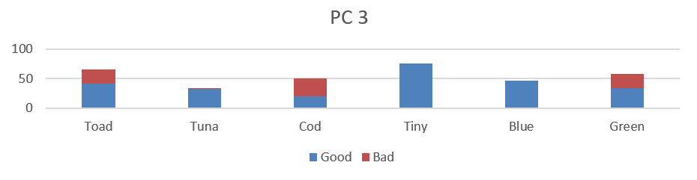
Methodology -Sequencing
Group
Sequence
BCD
Group
Sequence | Sum
 | Purity
Notes:
以方才產生的PC3特徵組為例，此處嘗試排序此群組當中的6個二元特徵

Slide 30
Methodology -Sequencing
Group
Sequence
BCD
Group
Sequence | Sum
 | Purity
Column Sum
Type Purity
Notes:
此為依據特徵數值總合排序，
二元特徵總合通常表示了的該類別的出現頻率，同時代表了該類別具有相當多的資料個數。
該排序目的在於將總和較少的二元特徵置於群組左方，如此那些含有此稀有二元特徵的少量樣本便會在編碼時被投影到離數線原點較遠的位置
以利區分出這些與眾不同、較偏離整體資料分布的離群樣本。

Slide 31
Methodology -Sequencing
Group
Sequence
BCD
Group
Sequence | Sum
 | Purity
Column Sum
Type Purity
Notes:
此則為監督式的排序方式，依據特徵類別的純粹度進行排序
其將最有分類價值、類別純度越高的資料分布於特徵群組的前端、與後端，而中間段的特徵則是最不純粹的
當群組中的二元特徵經由BCD轉換為數值資料時，兩種類別會因為這些被置於前方、含有資訊與分類價值的二元特徵的緣故，編碼出兩種數值差異大的兩種數值
以下

Slide 32
Methodology -Sequencing
Group
Sequence
BCD
Group
Sequence | No Seq.
 | Purity
BCD value
No Seq.
Purity
Notes:
為了驗證排序對於編碼後產生的數值資料是否具有影響，這裡仍以方才產生的PC3特徵組為例，
對比不進行排序，以及排序後的數值資料
In fact, sequencing is decisively importance to the new encoded numerical value. These figures show how the new data will distributed in numerical feature by the sequence at the left, if a certain sequence can make these two types be clearly separated in numerical value, will makes classifier easily to find the cut point in this new feature.
In a nut shell, a good sequence can make our encoded numerical data easier to be classified.

Slide 33
Methodology -Sequencing
Group
Sequence
BCD
Group
Sequence | No Seq.
 | Purity
BCD value
No Seq.
Purity
Notes:
右圖呈現的微根據不排序、以及特徵純粹度兩種排序方式後，經由BCD編碼所產生的數值資料
可以看到排序對於編碼數值有著明顯的影響，對於常規的分類模型而言，
依據優勢的排序方式將使產生的數值特徵可以在數線上找到一個更佳的數值切分點
來區分出紅色與藍色兩種資料，因此能使模型達到較好的分類成果
簡而言之，好的排序將協助模型區分目標類別，而這便是進行排序的原因

Slide 34
Methodology -Sequencing
Group
Sequence
BCD
Grouped by PCA | Sequenced by column sum
Notes:
此為依據PCA群組，再以特徵總合重新排序組內特徵的成果
In the right-hand side, we can see the columns have been rearrange with its columns sum decreasingly.
But why bother to rearrange the sequence of the columns? Will this matter?

Slide 35
Methodology -BCD code
Group
Sequence
BCD
Group
Sequence
BCD |  | Sorted Column Group |  |  |  |  |  |  | Type
 |  | Blue | Tuna | Tiny | Toad | Green | Cod
33 |  | 1 | 0 | 0 | 0 | 0 | 1 |  | Good
36 |  | 1 | 0 | 0 | 1 | 0 | 0 |  | Good
26 |  | 0 | 1 | 1 | 0 | 1 | 0 |  | Bad
14 |  | 0 | 0 | 1 | 1 | 1 | 0 |  | Bad
Last but not least, using Binary Coded Decimal to transforming feature groups into numerical value.
BCD
Ranked BCD
Decimal digit | BCD
 | 8 | 4 | 2 | 1
0 | 0 | 0 | 0 | 0
1 | 0 | 0 | 0 | 1
2 | 0 | 0 | 1 | 0
3 | 0 | 0 | 1 | 1
4 | 0 | 1 | 0 | 0
5 | 0 | 1 | 0 | 1
6 | 0 | 1 | 1 | 0
7 | 0 | 1 | 1 | 1
8 | 1 | 0 | 0 | 0
9 | 1 | 0 | 0 | 1
Notes:
最後一步便是以Binary coded decimal 的方式，協助轉換特徵組成為整數數值。
本研究所採用8421-BCD，其概念相當直接，即是將一連串的二元數值十位數化。
假設某樣本在一特徵群組內的二元特徵數值依序為0、1、1、0，則其轉換後的十位數數值為6
便以6作為該樣本的新數值特徵

Slide 36
Methodology -BCD code
Group
Sequence
BCD
Group
Sequence
BCD |  | Sorted Column Group |  |  |  |  |  |  | Type
 |  | Blue | Tuna | Tiny | Toad | Green | Cod
33 |  | 1 | 0 | 0 | 0 | 0 | 1 |  | Good
36 |  | 1 | 0 | 0 | 1 | 0 | 0 |  | Good
26 |  | 0 | 1 | 1 | 0 | 1 | 0 |  | Bad
14 |  | 0 | 0 | 1 | 1 | 1 | 0 |  | Bad
Notes:
在此，則以先前已由PCA群組、純粹度排序的特徵組為例
But how to transform multiple binary value into numerical by BCD? In the right is the how the BCD works. It basically is by decimalize a sample's grouped columns as binary values. Like the sample here, 2 power 5 plus 2 power 0 is 33 in total.
As you can imagine, if we can put a more Informative column at front, it can determine the BCD value more than other columns do.
Like the color: blue checkbox only checked by the good animals, and putting it at front will largen both their BCD value and their gap to the bad animals on the new numerical feature.
Hence putting informative column at front can help us in output a better numerical value in separating two types.

Slide 37
Methodology -BCD code
Group
Sequence
BCD
Group
Sequence
BCD |  | Sorted Column Group |  |  |  |  |  |  | Type
 |  | Blue | Tuna | Tiny | Toad | Green | Cod
33 |  | 1 | 0 | 0 | 0 | 0 | 1 |  | Good
36 |  | 1 | 0 | 0 | 1 | 0 | 0 |  | Good
26 |  | 0 | 1 | 1 | 0 | 1 | 0 |  | Bad
14 |  | 0 | 0 | 1 | 1 | 1 | 0 |  | Bad
Notes:
可見在Blue這個欄位中，僅具有健康類別的樣本，而此欄位被排序在特徵組的最左側
而愈左側的特徵對於BCD數值大小具有更大的影響；同時採用了特徵純粹度的排序，
越左側的特徵在比例上有著更多的健康樣本。因此，健康樣本傾向於產出更大的BCD數值
反之，生病的樣本傾向於產生較小的BCD數值

Slide 38
Methodology -BCD code
Group
Sequence
BCD
Group
Sequence
BCD |  | Sorted Column Group |  |  |  |  |  |  | Type
 |  | Blue | Tuna | Tiny | Toad | Green | Cod
33 |  | 1 | 0 | 0 | 0 | 0 | 1 |  | Good
36 |  | 1 | 0 | 0 | 1 | 0 | 0 |  | Good
26 |  | 0 | 1 | 1 | 0 | 1 | 0 |  | Bad
14 |  | 0 | 0 | 1 | 1 | 1 | 0 |  | Bad
Notes:
如此一來，在經由BCD編碼之後，經由純粹度排序的特徵組
相比於原先的群組順序而言，更能導出容易區分類別的數值特徵
因此能達到較好的分類成果。如果能設法找尋出好的特徵排序方式，
對於新數值資料的分類任務將有莫大的幫助。

Slide 39
Methodology -BCD code
Group
Sequence
BCD
Notes:
然而，新編碼過後BCD數值也可能因為原先數字1的分布稀疏，也將導致編碼後的數值資料全距過大、且分布稀疏。
例如：若組內二元特徵的個數為十個，則此群組編碼出的新數值特徵範圍將達到0至1024之間。
而在這0至1024的數線之上的資料呈現零散分佈

Slide 40
Methodology -BCD code
Group
Sequence
BCD
Notes:
為此，可嘗試透過Ranked BCD排名編碼，根據BCD大小進行排序，以取代原先的數值
在改善編碼後資料之間的稀疏程度的同時，也能避免儲存過大正整數，因而導致整數溢位等問題
但對於分類模型而言，僅需在數線上決定切分點，不論資料全距，兩者的差異對分類模型的影響並不是相當顯著

Slide 41
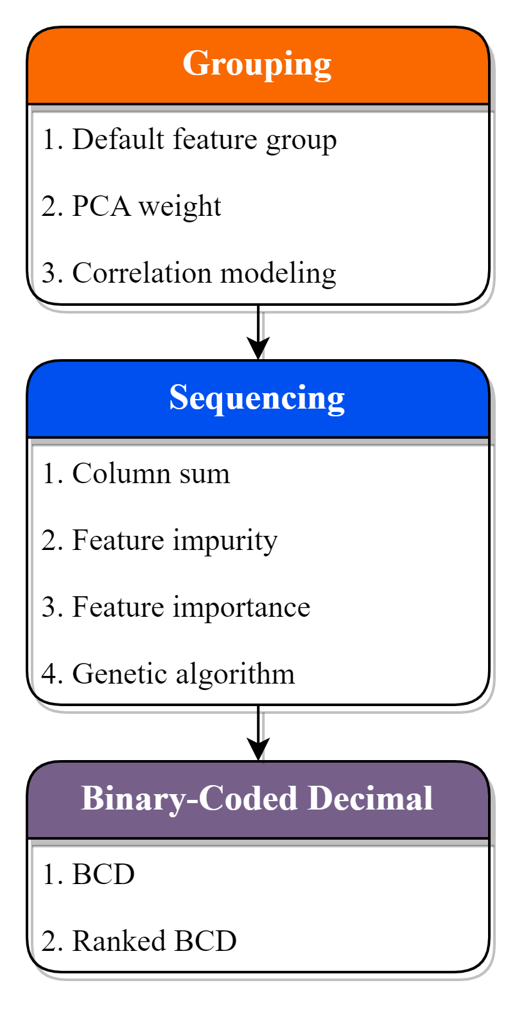
Methodology -sum up
1. | Column Grouping
 | Clustering related or similar columns together into groups.
2. | Sequencing
 | Rearrange columns in group, for a more distinctive /competitive BCD value.
3. | Binary-Coded Decimal
 | Transform column groups into a numerical value with BCD.
Original
Randomly
Impurity
Notes:
以上便是本研究方法的詳細介紹，並於此進行研究方法的小結
首先第一步驟是依照聚類、或是特徵選取的方式群組二元特徵

Slide 42
Methodology -sum up
1. | Column Grouping
 | Clustering related or similar columns together into groups.
2. | Sequencing
 | Rearrange columns in group, for a more distinctive /competitive BCD value.
3. | Binary-Coded Decimal
 | Transform column groups into a numerical value with BCD.
Notes:
並接著對各個特徵組內的二元特徵進行一致性的排序，
以求產生出有著更具有判別性、分類優勢的整數資料

Slide 43
Methodology -sum up
1. | Column Grouping
 | Clustering related or similar columns together into groups.
2. | Sequencing
 | Rearrange columns in group, for a more distinctive /competitive BCD value.
3. | Binary-Coded Decimal
 | Transform column groups into a numerical value with BCD.
Notes:
最後藉由Binary coded decimal，協助轉換各個二元特徵組成為整數特徵

Slide 44
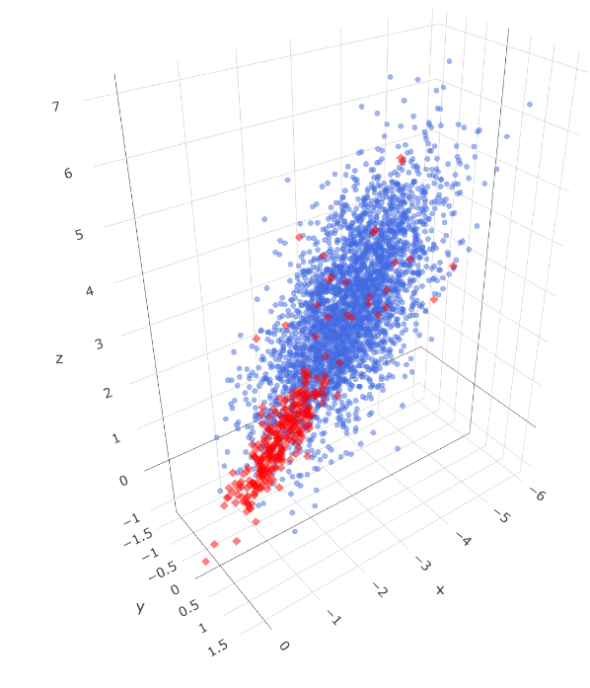


Case study
In Case study, we compare classification results with the commonly used variable encoding method under different datasets.
Simulated continuous datasets
UCI-Car evaluation dataset
Kaggle-Feature encoding challenge dataset
Notes:
為驗證本研究提出之高維二元特徵之聚合編碼技術及分析框架，
透過模擬出三維連續的二元分類資料，並依照比例切分為多個二元特徵作為資料集；
同時也對於UCI，Kaggle等開源資料集平台上的類別特徵資料集進行研討，
以比較傳統變數編碼與所發展之方法產生的新數值資料，對於機器學習模型分類成效之影響。

Slide 45
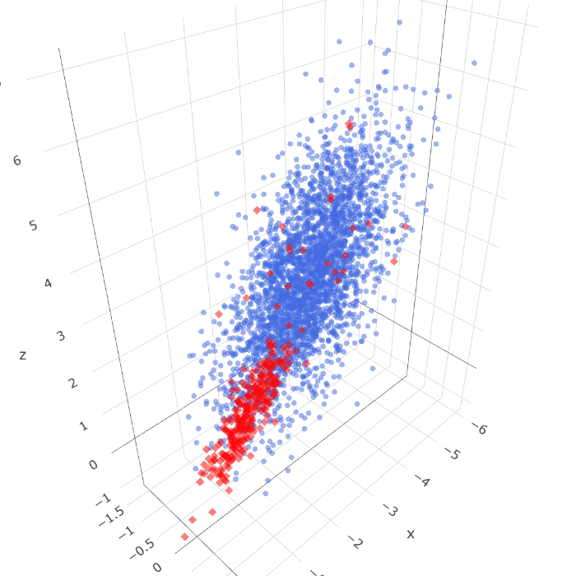
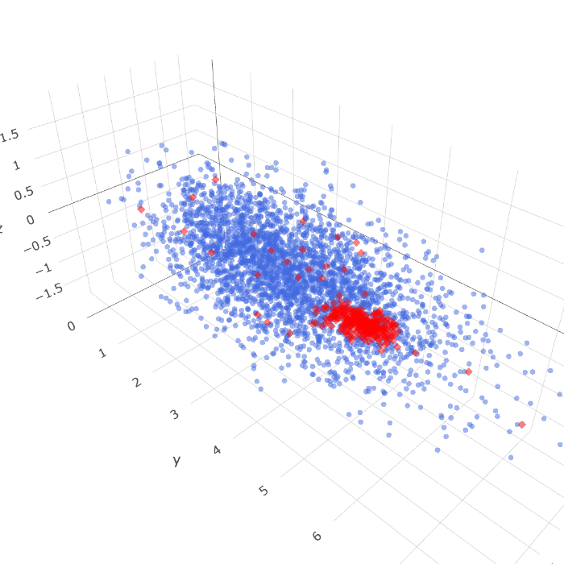
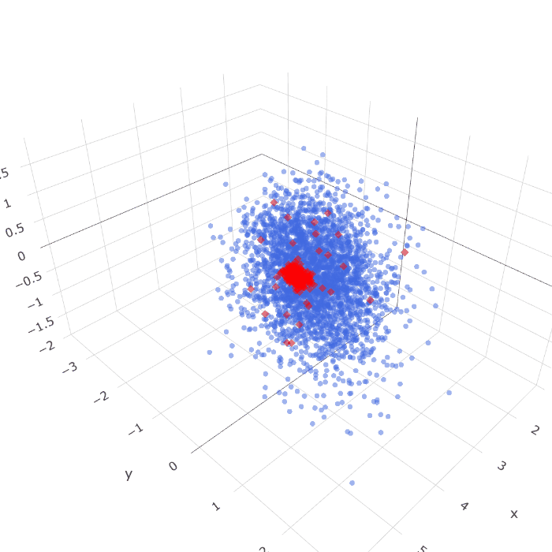
Simulated data -(3300 samples, 3000 Good, 300 Bad)
Dataset 1 |  | Dataset 2 |  | Dataset 3
Notes:
在案例分析的第一個小節中，我們將對模擬出的三種連續資料集做討論。
為了使生成資料具備分類價值與背景知識，本研究透過模擬三維座標點分布的方式，生成了兩種類別的浮點數座標
資料點具有X、Y、Z三維座標資訊，且區分為三百個紅色的少數類別、與三千個藍色的多數類別；兩種類別各自服從自身的資料分布，
且在多數的藍色類別中，可見到有少量的紅色類別躁點存在，目的在於增加分類任務的複雜度。
可見資料集一二中，兩種類別較為混雜；而資料集三則

Slide 46
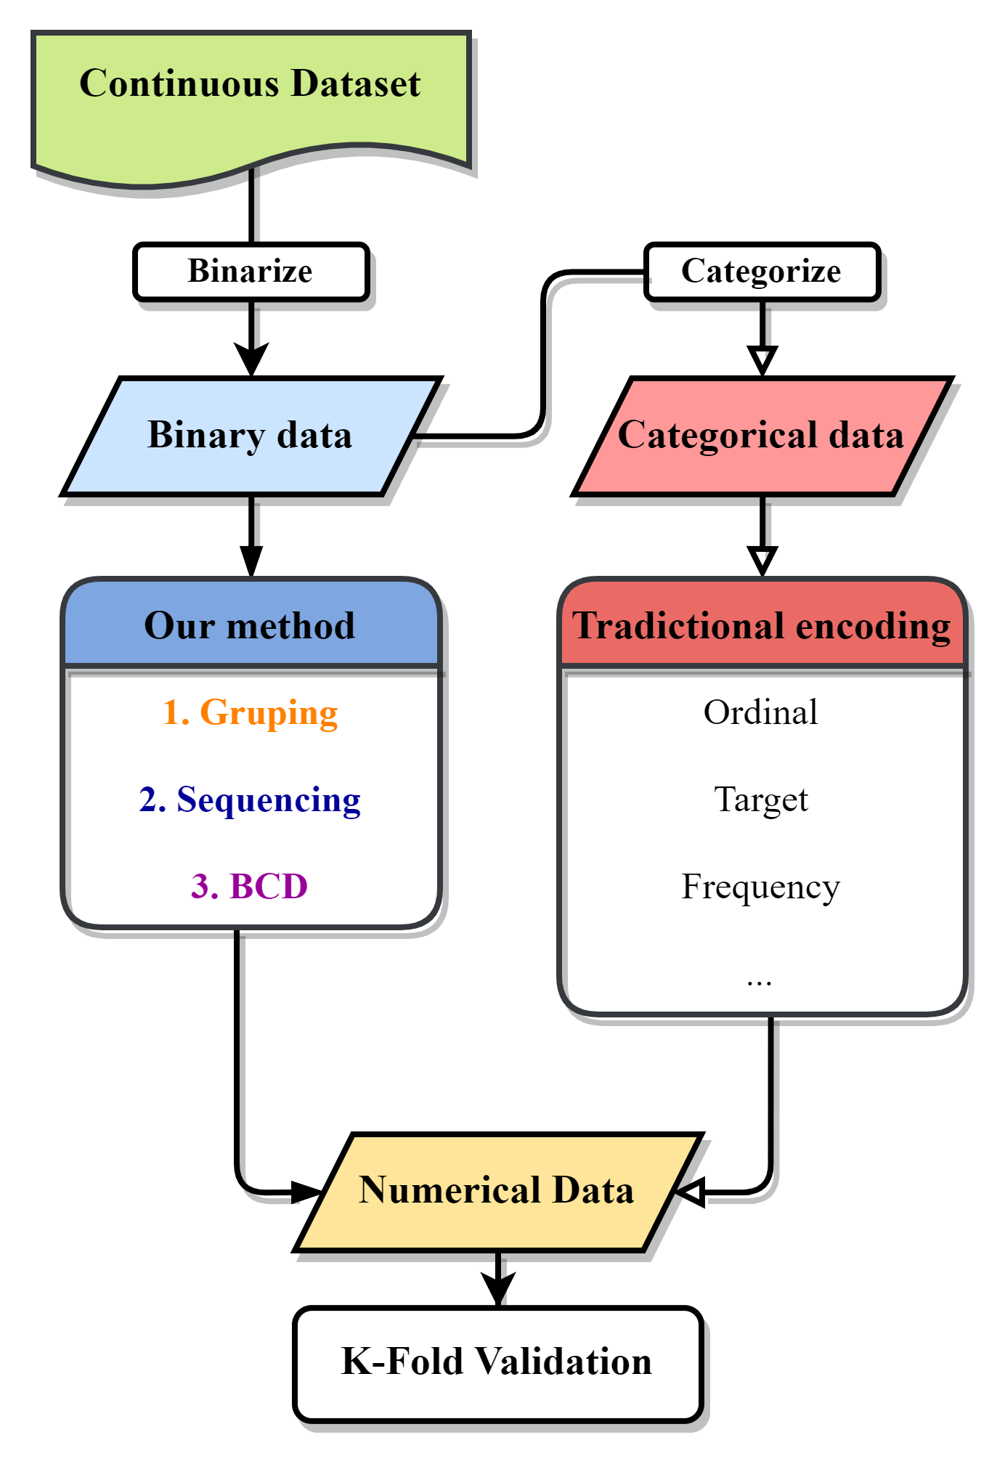
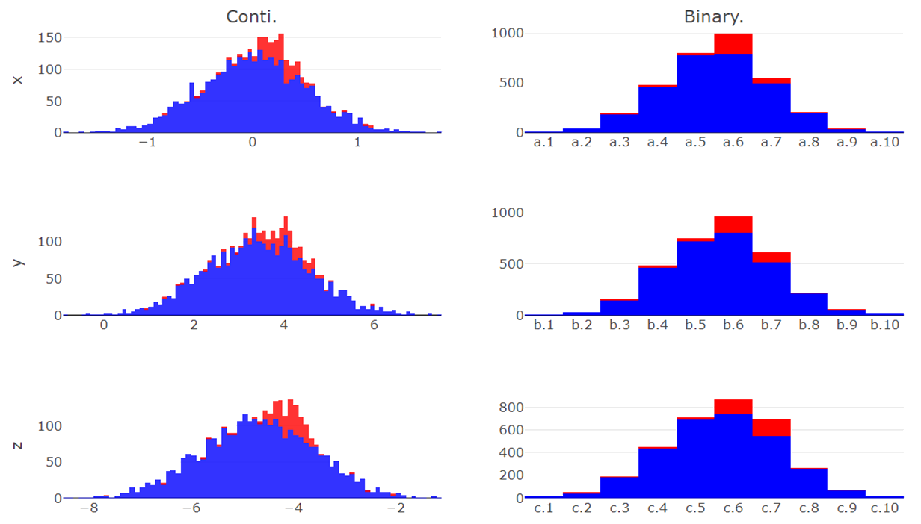
z.1 | z.2 | z.3 | z.4 | z.5 | z.6 | z.7 | z.8 | z.9 | z.10
y.1 | y.2 | y.3 | y.4 | y.5 | y.6 | y.7 | y.8 | y.9 | y.10
x.1 | x.2 | x.3 | x.4 | x.5 | x.6 | x.7 | x.8 | x.9 | x.10
Simulated data - binarize
Continuous Data | Binarize Data
counts
counts
X
counts
counts
Y
counts
counts
Z
Notes:
左圖為整體實驗流程，先透過二元化連續座標軸，以產生二元分佈資料以作為本研究方法輸入
再由二元分佈資料轉換出類別資料，以經過傳統變數編碼方式產生數值資料，最後由k-fold validations進行分類成果的比較
此分佈圖表示了原始連續資料於三個座標軸上的資料分布情形，且少數與多數類別由顏色區分；
而後根據欲劃分出的二元特徵各數，對此三個連續座標軸進行二元化處理

Slide 47
z.1 | z.2 | z.3 | z.4 | z.5 | z.6 | z.7 | z.8 | z.9 | z.10
y.1 | y.2 | y.3 | y.4 | y.5 | y.6 | y.7 | y.8 | y.9 | y.10
x.1 | x.2 | x.3 | x.4 | x.5 | x.6 | x.7 | x.8 | x.9 | x.10
Simulated data - binarize
Continuous Data | Binarize Data
counts
counts
X
counts
counts
Y
counts
counts
Z
Notes:
假設與從中劃分出30個二元特徵，便依據比例切分各個座標軸的全距
並將資料點劃分入新產生的二元特徵之中，如此，便產生了具備分類知識的二元特徵資料

Slide 48
z.1 | z.2 | z.3 | z.4 | z.5 | z.6 | z.7 | z.8 | z.9 | z.10
y.1 | y.2 | y.3 | y.4 | y.5 | y.6 | y.7 | y.8 | y.9 | y.10
x.1 | x.2 | x.3 | x.4 | x.5 | x.6 | x.7 | x.8 | x.9 | x.10
Simulated data - Categorize
Categorical Data | Binarize Data
Instances | X | Y | Z
1 | x.2 | y.9 | z.4
2 | x.1 | y.8 | z.2
3 | x.9 | y.1 | z.6
4 | x.5 | y.7 | z.8
5 | x.3 | y.1 | z.8
6 | x.5 | y.6 | z.3
7 | x.7 | y.5 | z.4
⁝ | ⁝ | ⁝ | ⁝
3300 | x.4 | y.8 | z.1
Instances | x.1 | x.2 | x.3 | x.4 | x.5 | x.6 | … | z.9 | z.10
1 | 0 | 1 | 0 | 0 | 0 | 0 | … | 0 | 0
2 | 1 | 0 | 0 | 0 | 0 | 0 | … | 0 | 0
3 | 0 | 0 | 0 | 0 | 0 | 0 | … | 0 | 0
4 | 0 | 0 | 0 | 0 | 1 | 0 | … | 0 | 0
5 | 0 | 0 | 1 | 0 | 0 | 0 | … | 0 | 0
6 | 0 | 0 | 0 | 0 | 1 | 0 | … | 0 | 0
7 | 0 | 0 | 0 | 0 | 0 | 0 | … | 0 | 0
⁝ | ⁝ | ⁝ | ⁝ | ⁝ | ⁝ | ⁝ | ⁝ | ⁝ | ⁝
3300 | 0 | 0 | 0 | 1 | 0 | 0 | … | 0 | 0
Notes:
而以表格方式呈現方才二元化的連續座標軸
可見原先 的連續資料現以被劃分成為30個二元特徵
而根據此30個二元特徵與其群組資訊

Slide 49
Simulated data - Categorize
Categorical Data | Binarize Data
Instances | X | Y | Z
1 | x.2 | y.9 | z.4
2 | x.1 | y.8 | z.2
3 | x.9 | y.1 | z.6
4 | x.5 | y.7 | z.8
5 | x.3 | y.1 | z.8
6 | x.5 | y.6 | z.3
7 | x.7 | y.5 | z.4
⁝ | ⁝ | ⁝ | ⁝
3300 | x.4 | y.8 | z.1
Instances | x.1 | x.2 | x.3 | x.4 | x.5 | x.6 | … | z.9 | z.10
1 | 0 | 1 | 0 | 0 | 0 | 0 | … | 0 | 0
2 | 1 | 0 | 0 | 0 | 0 | 0 | … | 0 | 0
3 | 0 | 0 | 0 | 0 | 0 | 0 | … | 0 | 0
4 | 0 | 0 | 0 | 0 | 1 | 0 | … | 0 | 0
5 | 0 | 0 | 1 | 0 | 0 | 0 | … | 0 | 0
6 | 0 | 0 | 0 | 0 | 1 | 0 | … | 0 | 0
7 | 0 | 0 | 0 | 0 | 0 | 0 | … | 0 | 0
⁝ | ⁝ | ⁝ | ⁝ | ⁝ | ⁝ | ⁝ | ⁝ | ⁝ | ⁝
3300 | 0 | 0 | 0 | 1 | 0 | 0 | … | 0 | 0
Notes:
得以轉化出資料的類別變數型態
此兩種資料乃為一體兩面，僅僅在呈現方式上有所差異，但其本質代表的資料質實無異
類似於原始類別資料，之於獨熱編碼轉換出的二元資料。
如此，便得以為本研究方法，與傳統變數編碼方法，設定出相同的起跑線
而後進行分類成果的比較

Slide 50
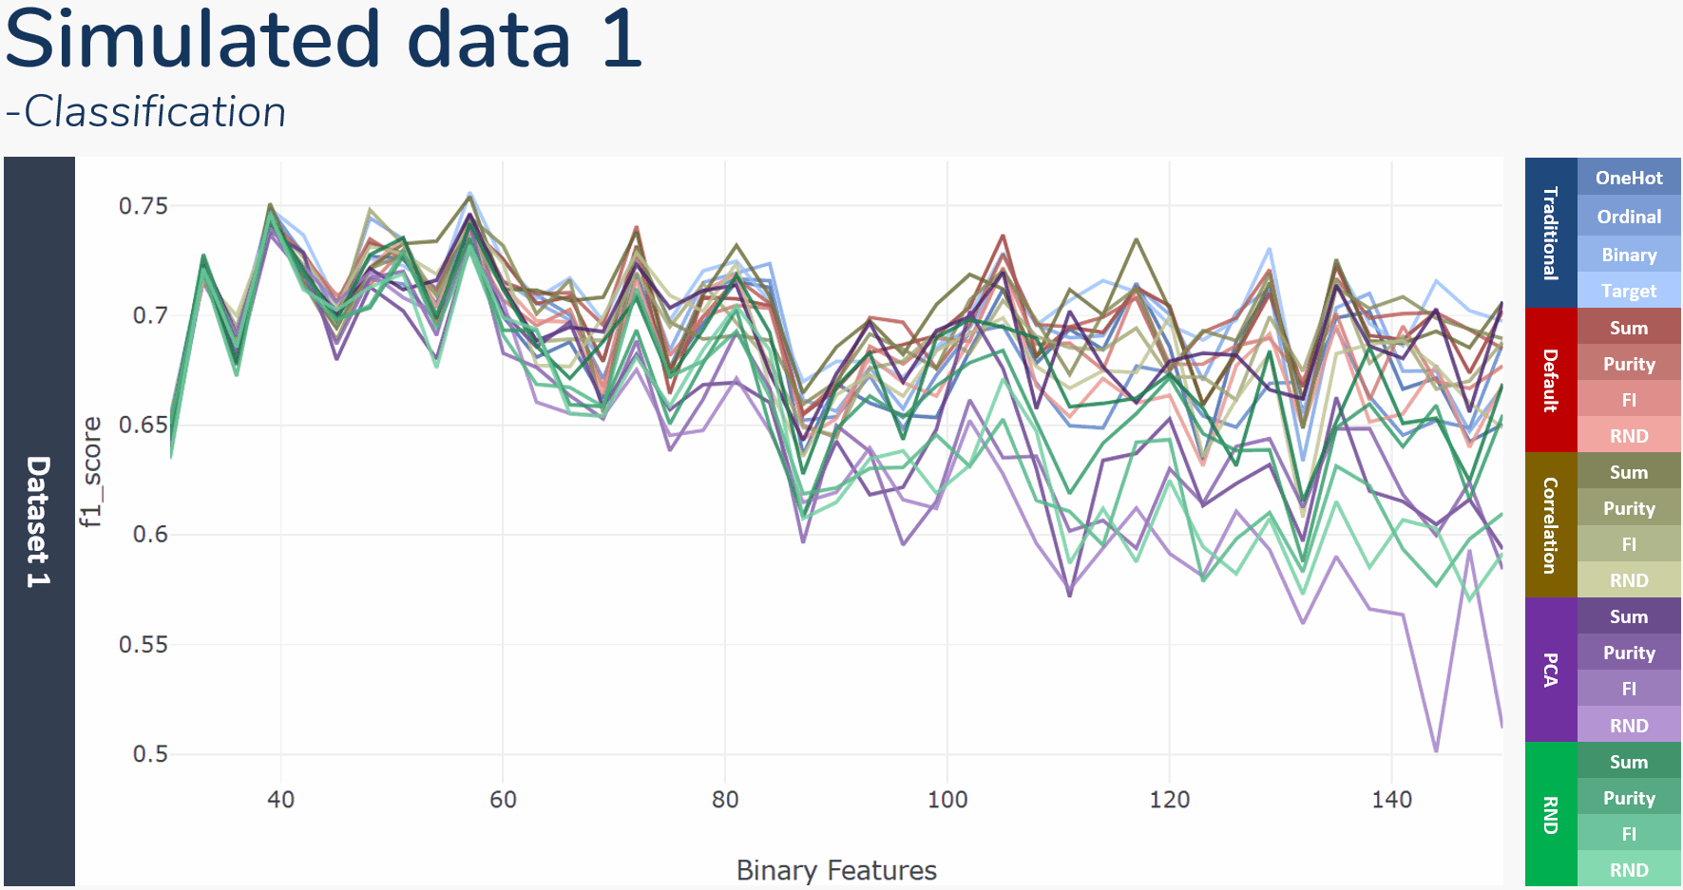
Notes:
在分類結果的評比中，與OneHot, Binary, Ordinal, 與Target encoding等4種傳統的變數編碼比較
以及本研究四種群組方式，分別是根據原先群組資訊、主成分分析、皮爾森相關係數與隨機群組
結合4種排序方式，分別是特徵總和、類別純粹度、特徵重要性、與隨機排列
並以LightGBM梯度提升決策樹作為分類模型，且f1 score作為數值資料衡量標準
此折線圖則顯示了在切分出不同的二元特徵之下，各種方法k-folds驗證後的平均f1 score變化
觀察了先前的折線圖可見，在切分的二元變數數量較少時，所有變數編碼產生的數值資料有著相近的分類成績；
然而，隨著所切分的二元變數個數增加，變數編碼產生數值資料的分類成績之間的變異也逐漸增加、
且分類成績也有著緩步下降的趨勢，類似在維度災難發生時導致的模型成果下降。

Slide 51
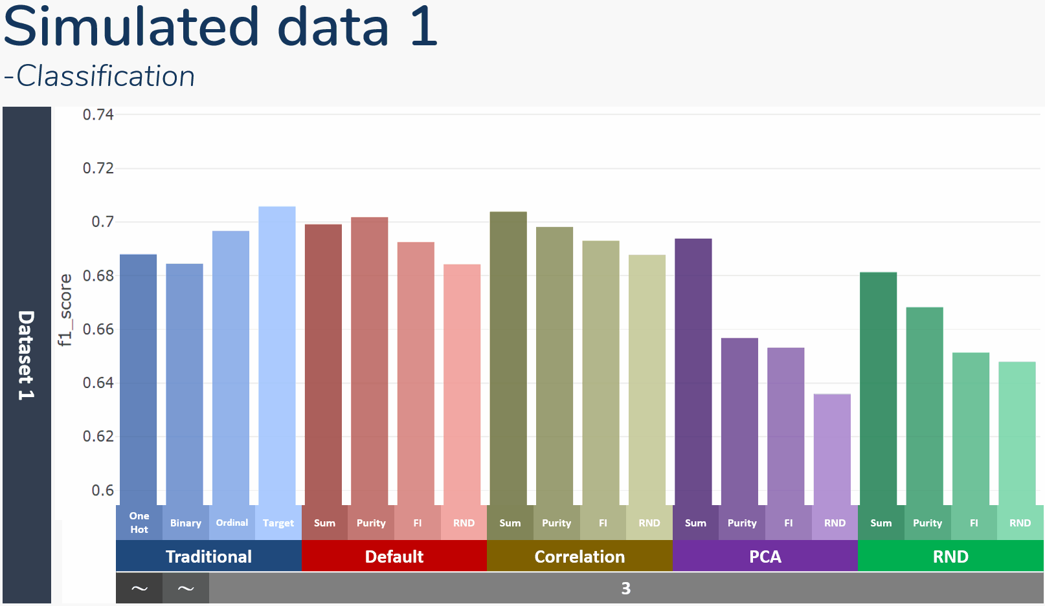
Simulated data 1 -Classification
Notes:
此直方圖則顯示了方才折線圖的平均成績，底下黑灰色欄位中則表示了該方法產生新數值資料的特徵個數
可以發現OneHot, Binary encoding的特徵各數是不固定的，OneHot 資料即為切分出的整體二元特徵
而Binary encoding使用特徵數將少於全數二元特徵個數
其中值得注意的有RND排序方式，其皆產出群組中最低的分類成績

Slide 52
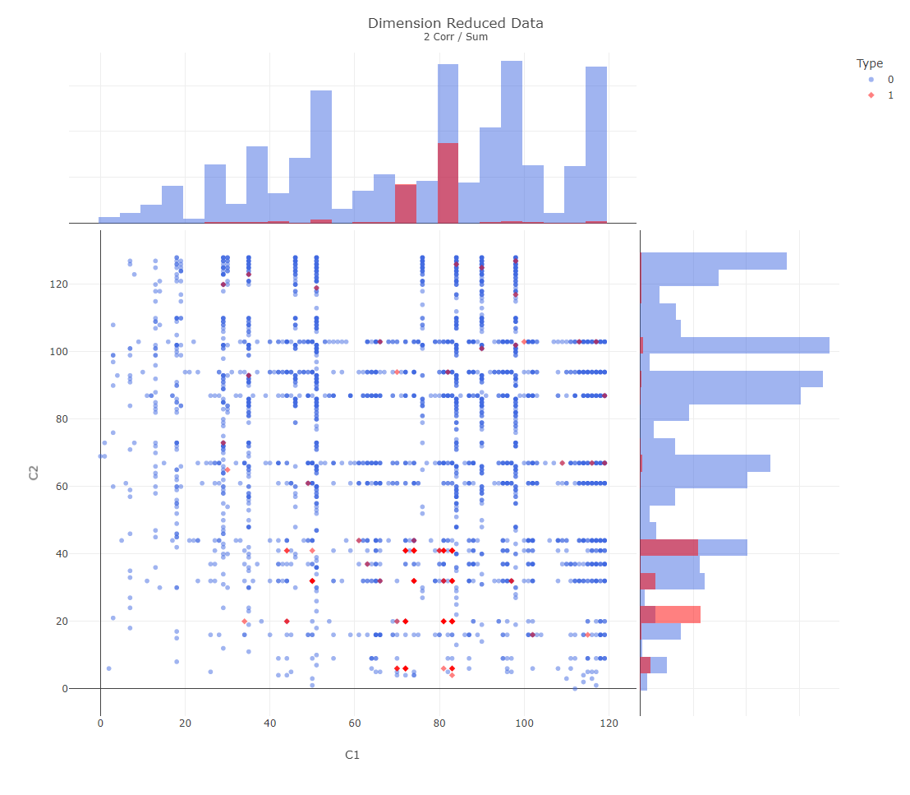
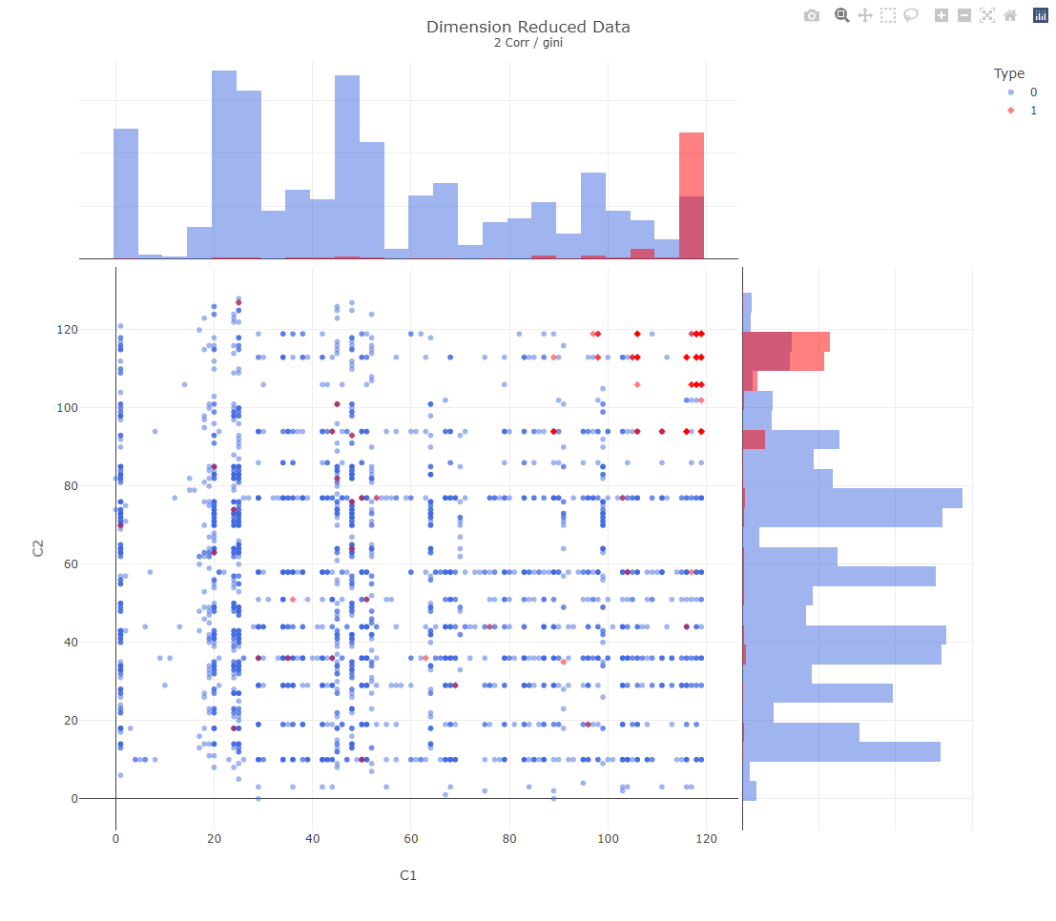
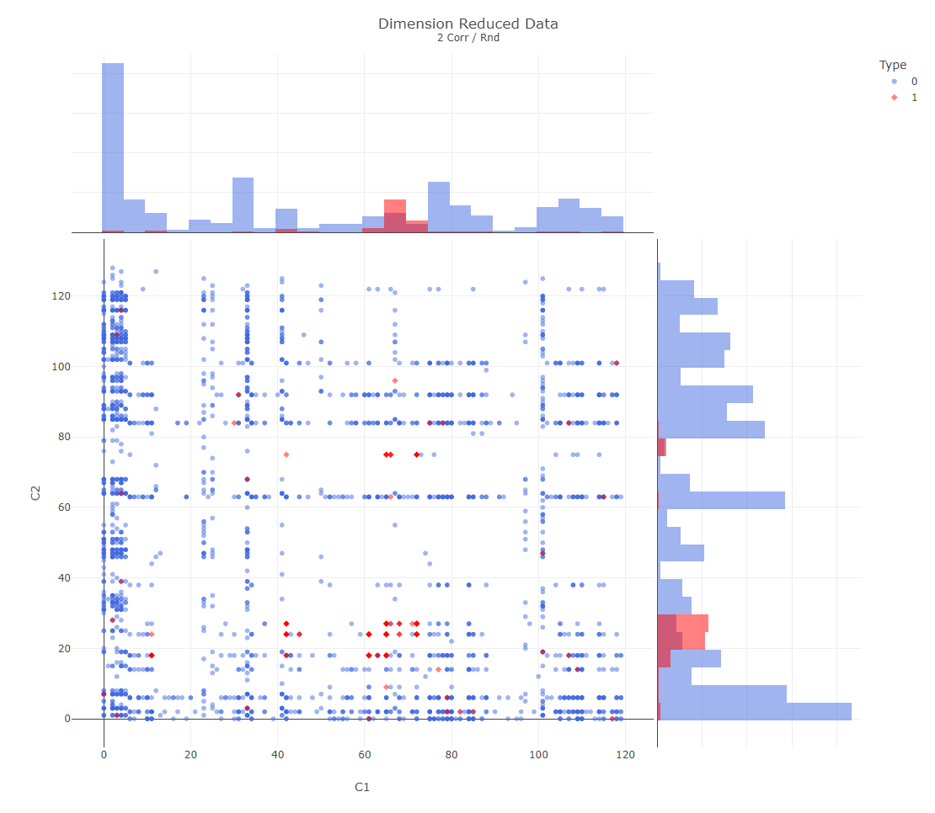
Simulated data -Dimension reduction
Sum | Impurity | RND
Notes:
本研究發展的二元變數編碼方式也可以做為二元資料的降維方法來使用。只需選定群組與排序方式，
便能將高維度的二元資料，轉變成僅具有群組個數維度的數值資料
若將群組個數設定成二維或是三維，即可將原先多維度的二元資料投影至可視覺化的維度進行分析，
亦可同時比較不同排序與群組方式的有效度。
如此三張圖，便是連續資料集三，在150個二元變數切分之下，經由相關係數群組，在經由不同排序後產生的二維資料分佈
可以明顯看出以純粹度排序的資料更能產生適合分類的數值資料，投影了兩種類別資料至數線的兩端，得以讓編碼後的數值資料更易以類別區分

Slide 53
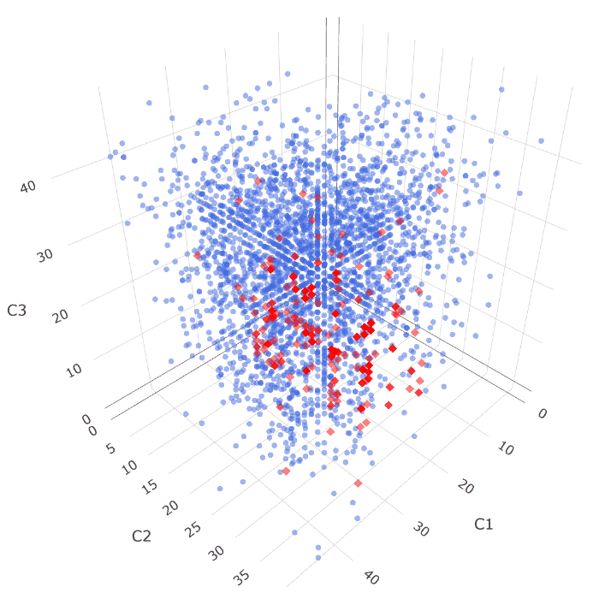
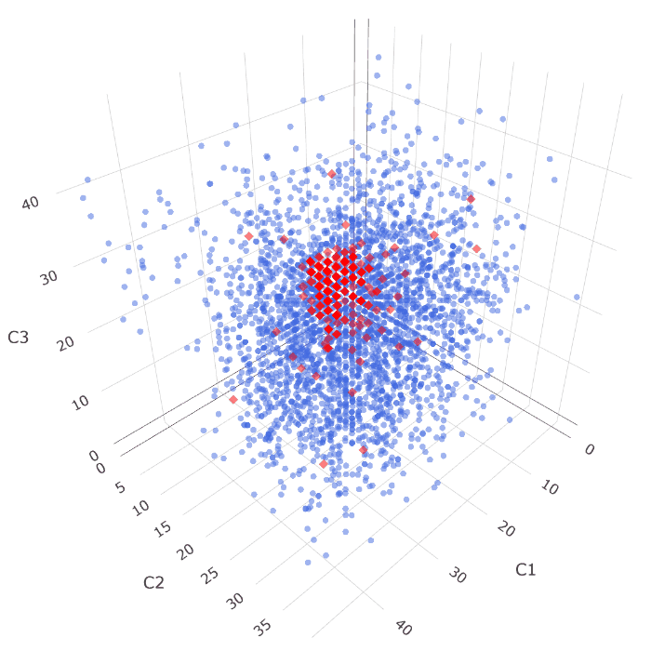
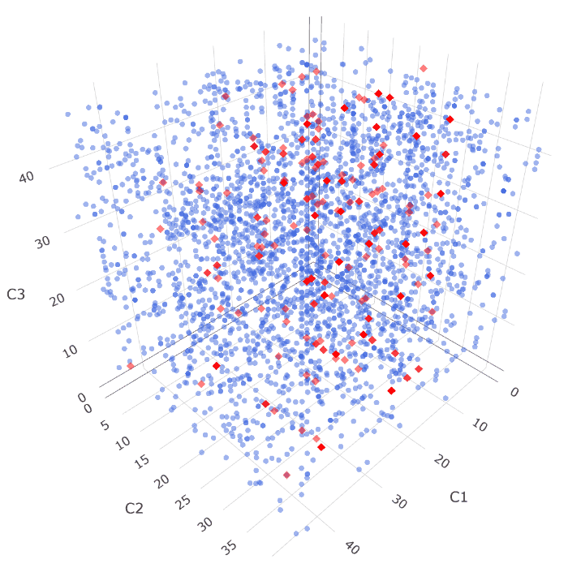
Simulated data -Dimension reduction
Sum | Impurity | RND
Notes:
也能將編碼後的資料做立體投影，更可以明顯感受出排序方法之間的差異程度
像是以隨機排列，兩類資料則與彼此相混雜，無法找出適合的切分點來區隔特徵
導致模型無法有效找出切分資料，使分類成果大受影響

Slide 54
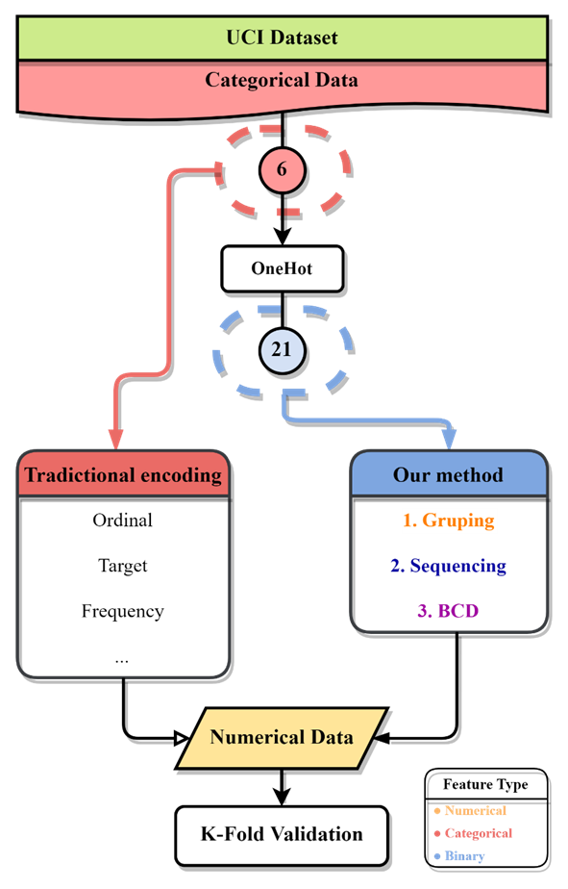
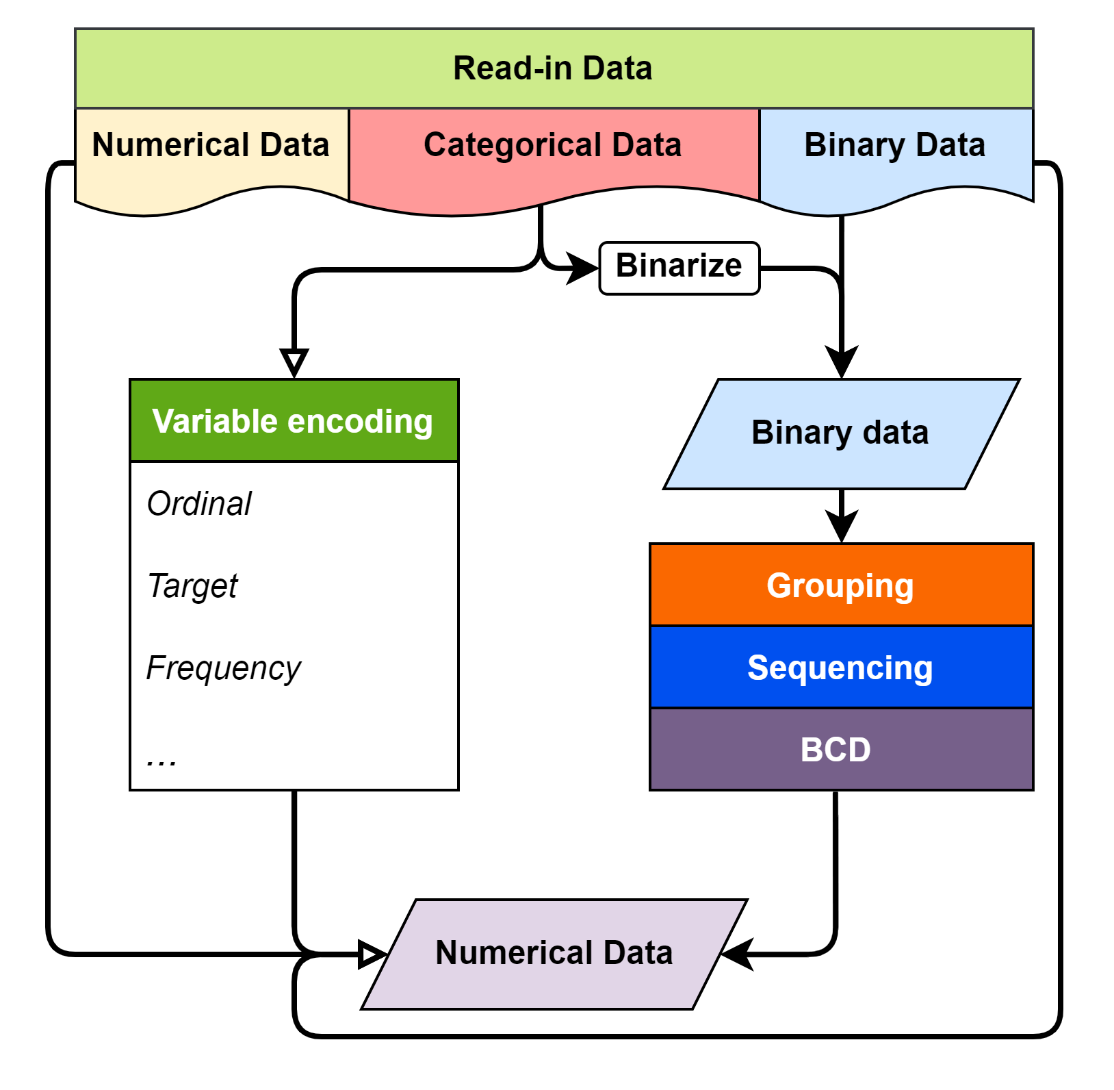
UCI dataset
Feature uniqueness of UCI car evaluation dataset
Price | Maintenance | Doors | Persons | Luggage boot | Safety | Evaluation
vhigh | vhigh | 2 | 2 | small | med | Acceptable
high | high | 3 | 4 | med | high | Unacceptable
med | med | 4 | more | big | low
low | low | 5more
Notes:
因應參考文獻中所涉及的變數編碼比較相關研究，於UCI線上資料及網站之中採用與其相同的標竿資料集，
此車輛評估資料集較為簡單，僅僅具有六個類別變數作為輸入，來預測車輛為可接受、或是不可接受的狀態

Slide 55
UCI dataset
Feature uniqueness of UCI car evaluation dataset
Price | Maintenance | Doors | Persons | Luggage boot | Safety | Evaluation
vhigh | vhigh | 2 | 2 | small | med | Acceptable
high | high | 3 | 4 | med | high | Unacceptable
med | med | 4 | more | big | low
low | low | 5more
Notes:
此6個類別變數經由OneHot encoding轉換之後，將產生21個二元變數，
以作為本研究方法輸入，並與傳統變數編碼相比較

Slide 56
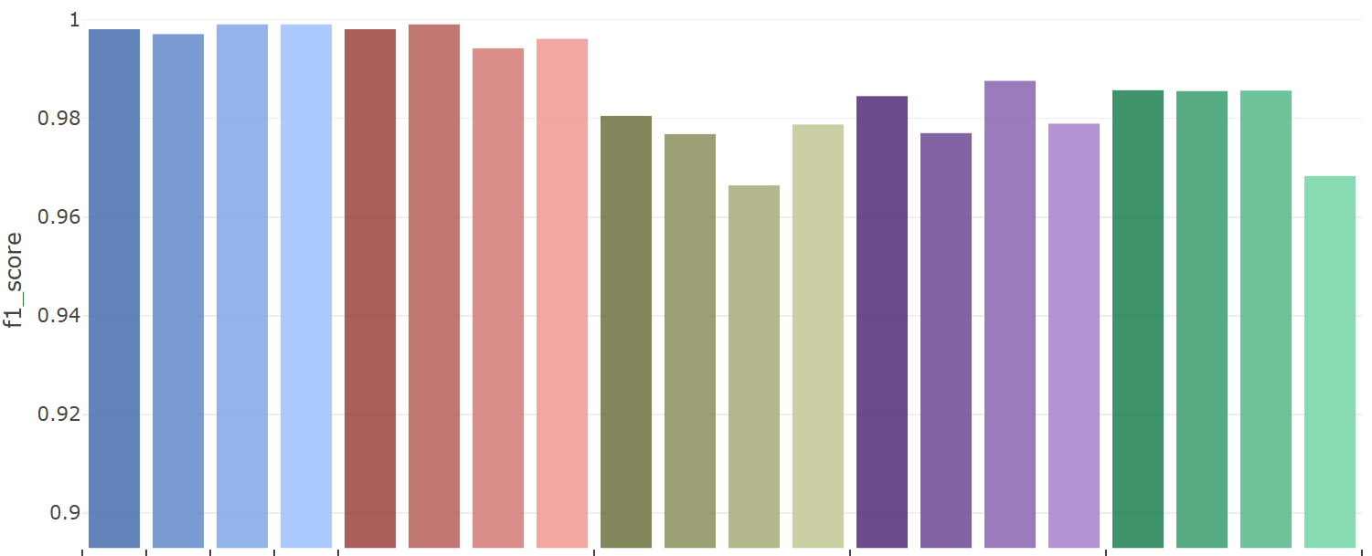
UCI dataset -Classification
Car Evaluations Dataset
 | One Hot | Binary | Ordinal | Target | Sum | Purity | FI | RND | Sum | Purity | FI | RND | Sum | Purity | FI | RND | Sum | Purity | FI | RND
 | Traditional |  |  |  | Default |  |  |  | Correlation |  |  |  | PCA |  |  |  | RND
 | 21 | 15 | 6
Notes:
可以看見傳統變數編碼方式、以及依照原先群組資訊而產生的數值資料集皆表現得相當優異，
甚至是單純的二元特徵資料即表現的相當不錯；反之，透過相關係數、主成分分析或隨機群組的方式皆造成分類成績的損失。
本研究推論此結果的原因有二：其一是此資料本身過於單純，且LightGBM在二十一個二元特徵之下仍能表現出不錯的分類能力，
當遭遇維度較低的二元資料問題時，使用本研究所發展之二元特徵編碼方式將無法有效用的使新數值資料的分類成績有大幅度的提升
其二則是群組方式仍需改進，根據相關係數、主成分分析的群組方式，皆無法達到根據原先的二元資料群組資訊相同的組分類平均，
而且也無法明顯的比隨機群組方式來的優越。

Slide 57
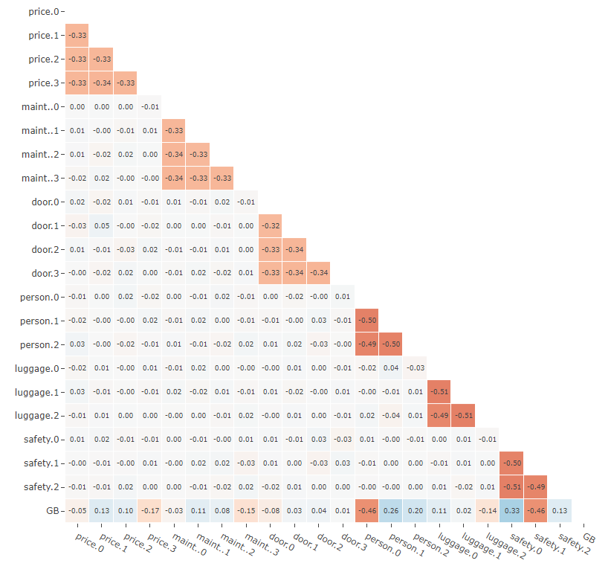
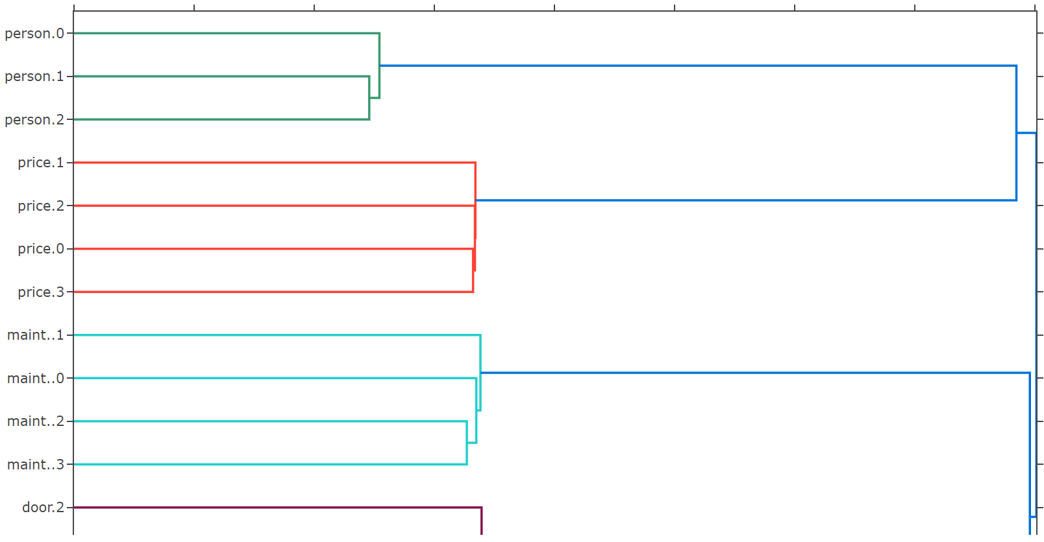
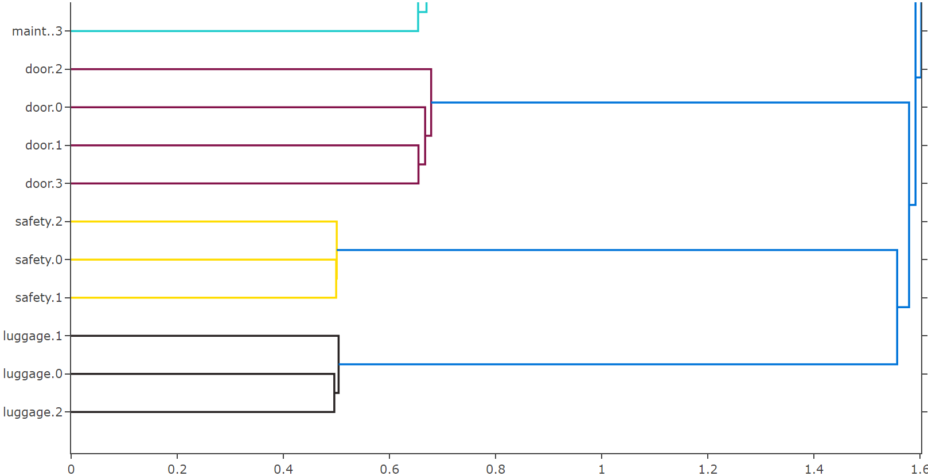
UCI dataset -Group by hierarchical clustering
Notes:
此處則改以階層聚類結合相關係數進行特徵群組，根據特徵之間的相關性，
找出獨熱編碼後產生的二元特徵之間互斥關係，並還原出原始的群組資訊。
此方法群組結果將與根據原始群組資訊群組有著完全相同輸出
可將其作為一種還原二元資料特徵群組資訊的方式
但作為本研究所預想的群組方式乃是著重在於藉由結合、群聚由不同類別特徵所產生的二元特徵，
以融合出更具有分類價值與資料特性的新數值特徵，
而此方法與依據原始群組資訊所產生特徵群組完全相同，
因此並未加入群組方法中與其餘方式做比較。

Slide 58

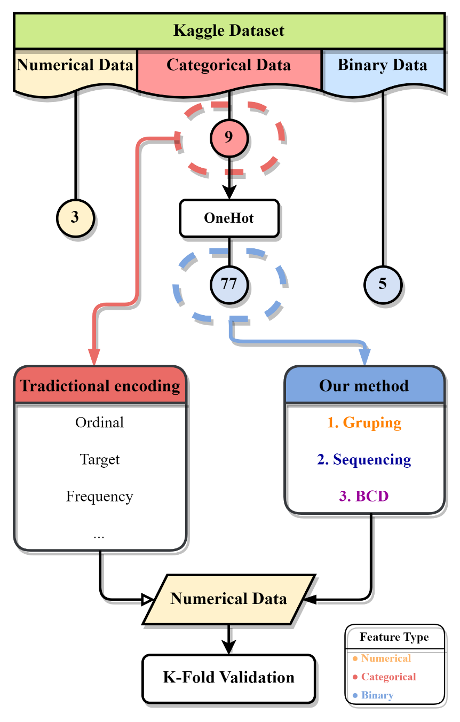
Kaggle dataset
Numerical feature uniqueness of Kaggle CFEC dataset
bin0 | bin1 | bin2 | bin3 | bin4 | ord0 | day | month | Target
0 | 0 | 0 | 0 | 0 | 1 | 1 | 1 | 0
1 | 1 | 1 | 1 | 1 | 2 | 2 | 2 | 1
 |  |  |  |  | 3 | 3 | 3
 |  |  |  |  |  | ⁝ | ⁝
 |  |  |  |  |  | 7 | 12
Categorical feature uniqueness of Kaggle CFEC dataset
nom0 | nom1 | nom2 | nom3 | nom4 | ord1 | ord2 | ord3 | ord4
Green | Triangle | Snake | Finland | Bassoon | Grandmaster | Cold | a | A
Blue | Trapezoid | Hamster | Russia | Piano | Expert | Hot | b | B
Red | Polygon | Lion | Canada | Theremin | Novice | Lava Hot | c | C
 | Square | Cat | Costa Rica | Oboe | Contributor | Boiling Hot | d | D
 | Star | Dog | China |  | Master | Freezing | ⁝ | ⁝
 | Circle | Axolotl | India |  |  | Warm | o | Z
Notes:
該資料集同時具有數值、類別與二元變數；且同為二元分類問題；經由獨熱編碼後將產生眾多二元特徵。

Slide 59
Kaggle dataset
Numerical feature uniqueness of Kaggle CFEC dataset
bin0 | bin1 | bin2 | bin3 | bin4 | ord0 | day | month | Target
0 | 0 | 0 | 0 | 0 | 1 | 1 | 1 | 0
1 | 1 | 1 | 1 | 1 | 2 | 2 | 2 | 1
 |  |  |  |  | 3 | 3 | 3
 |  |  |  |  |  | ⁝ | ⁝
 |  |  |  |  |  | 7 | 12
Categorical feature uniqueness of Kaggle CFEC dataset
nom0 | nom1 | nom2 | nom3 | nom4 | ord1 | ord2 | ord3 | ord4
Green | Triangle | Snake | Finland | Bassoon | Grandmaster | Cold | a | A
Blue | Trapezoid | Hamster | Russia | Piano | Expert | Hot | b | B
Red | Polygon | Lion | Canada | Theremin | Novice | Lava Hot | c | C
 | Square | Cat | Costa Rica | Oboe | Contributor | Boiling Hot | d | D
 | Star | Dog | China |  | Master | Freezing | ⁝ | ⁝
 | Circle | Axolotl | India |  |  | Warm | o | Z
Notes:
In the Kaggle dataset. We selected some of features as the read-in data. And it contains multiple data types, includes numerical, categorical, and binary. After one hot encoded, it will generate 75 dummy features.

Slide 60
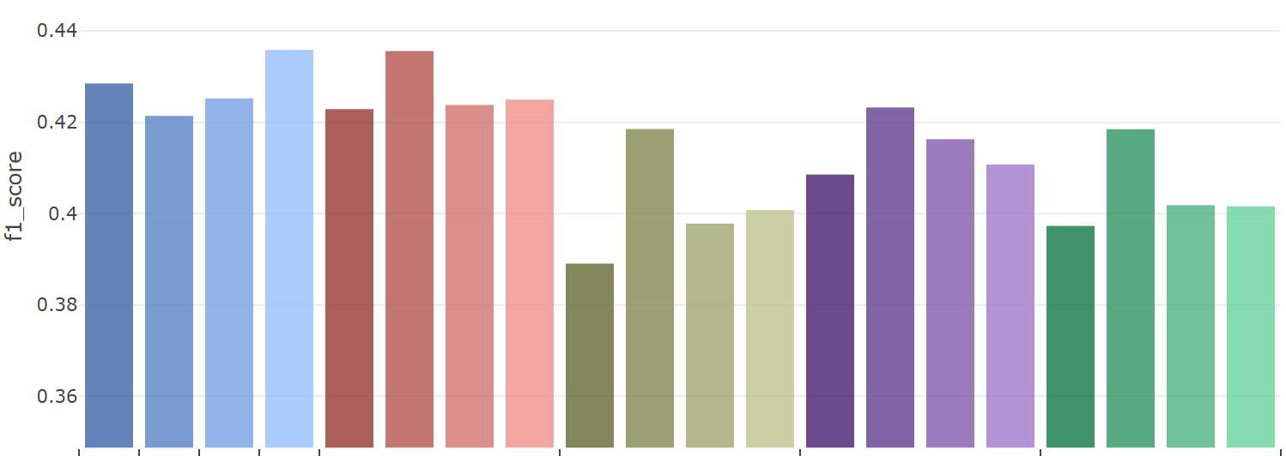
Kaggle dataset -Classification
Feature Encode Challenge
 | One Hot | Binary | Ordinal | Target | Sum | Purity | FI | RND | Sum | Purity | FI | RND | Sum | Purity | FI | RND | Sum | Purity | FI | RND
 | Traditional |  |  |  | Default |  |  |  | Correlation |  |  |  | PCA |  |  |  | RND
 | 85 | 37 | 17
Notes:
Although two the grouping method cannot outperform the default group or some traditional encoding methods,

Slide 61
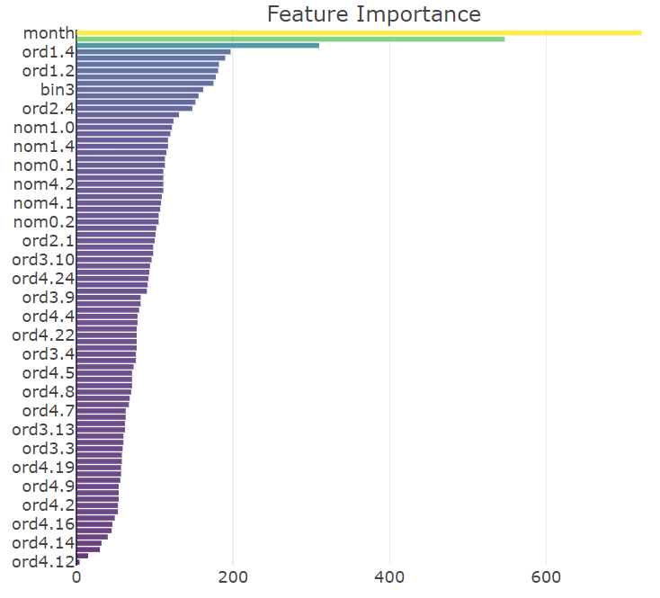
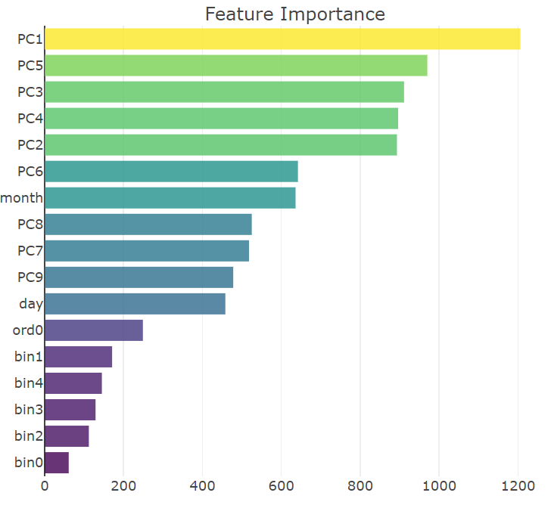
Kaggle dataset -Feature importance changes
Notes:
Although two the grouping method cannot outperform the default group or some traditional encoding methods,

Slide 62
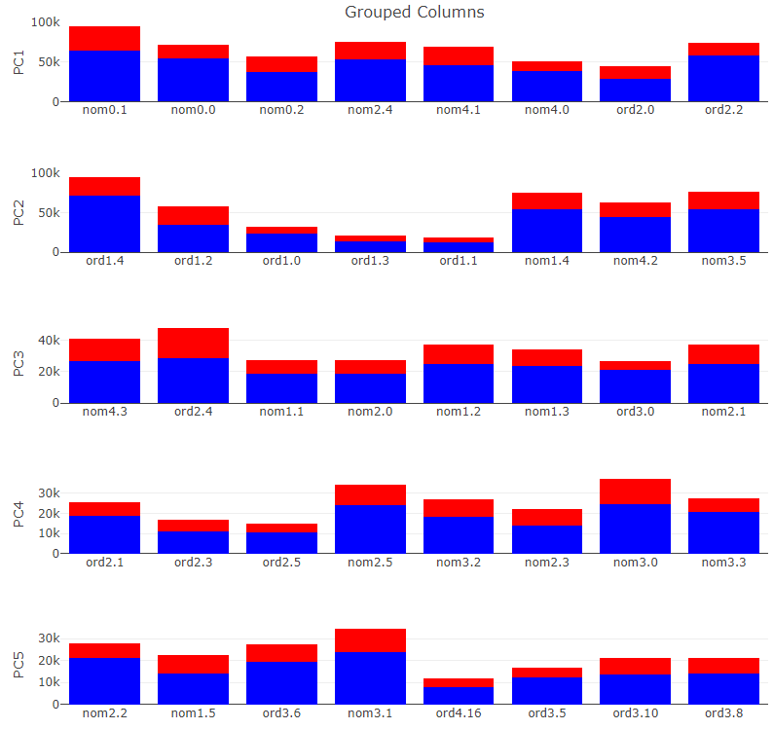
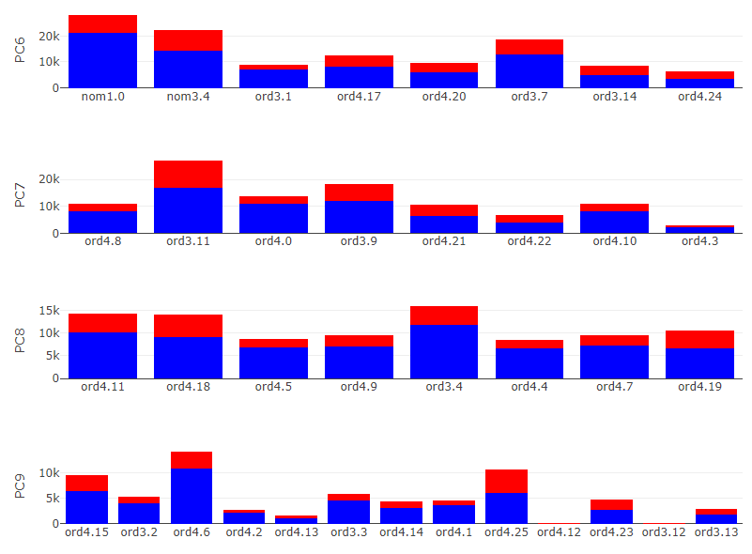
Kaggle dataset -Feature importance changes

Slide 63
Conclusion
In this research, we develop a method to encode binary feature data into numerical data, which can compress the binary features information to reduce dimension while remaining a certain level in ML model classification performance. The main advantage of this method compare to traditional encoding methods are:
Able to encoding binary features without group knowledge to numerical data.
Adjust the number of features of encoded numerical data unconstrainedly.
Preserve ML model performance with certain sequencing method.
As a dimension reduction method of high dimensional binary data.
Notes:
In conclusion, we formulate a way to encode non-grouped binary data into numerical, and can preserve the classification result with certain sequencing method. Or the method can be used as a dimension reduction method for binary data.
That’s all, thank you.

Slide 64
Future work
In this research, we develop a method to encode binary feature data into numerical data, which can compress the binary features information to reduce dimension while remaining a certain level in ML model classification performance. The main advantage of this method compare to traditional encoding methods are:
Encoding Binary features without group knowledge to numerical data.
Adjust the number of features of encoded numerical data.
Remain ML model performance with certain sequencing method.
Notes:
In conclusion, we formulate a way to encode non-grouped binary data into numerical, and can preserve the classification result with certain sequencing method. Or the method can be used as a dimension reduction method for binary data.
That’s all, thank you.

Slide 65
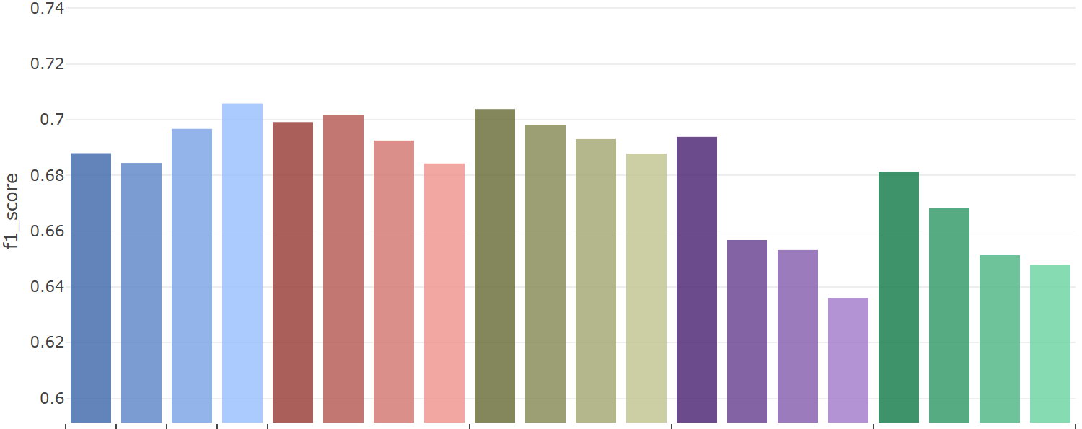
Simulated data 1 -Classification
Dataset 1
 | One Hot | Binary | Ordinal | Target | Sum | Purity | FI | RND | Sum | Purity | FI | RND | Sum | Purity | FI | RND | Sum | Purity | FI | RND
 | Traditional |  |  |  | Default |  |  |  | Correlation |  |  |  | PCA |  |  |  | RND
 | ～ | ～ | 3
Notes:
此直方圖則顯示了方才折線圖的平均成績，底下黑灰色欄位中則表示了該方法產生新數值資料的特徵個數
可以發現OneHot, Binary encoding的特徵各數是不固定的，OneHot 資料即為切分出的整體二元特徵
而Binary encoding使用特徵數將少於全數二元特徵個數
其中值得注意的有RND排序方式，其皆產出群組中最低的分類成績
且Target encoding皆聚有不俗表現，因為其本身即屬於一種監度式的變數編碼方式

Slide 66
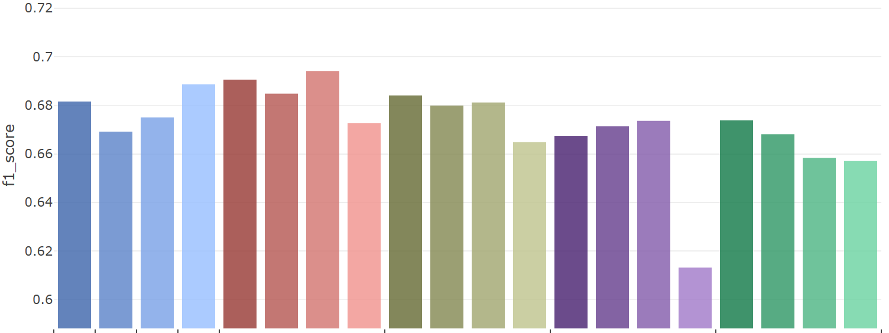
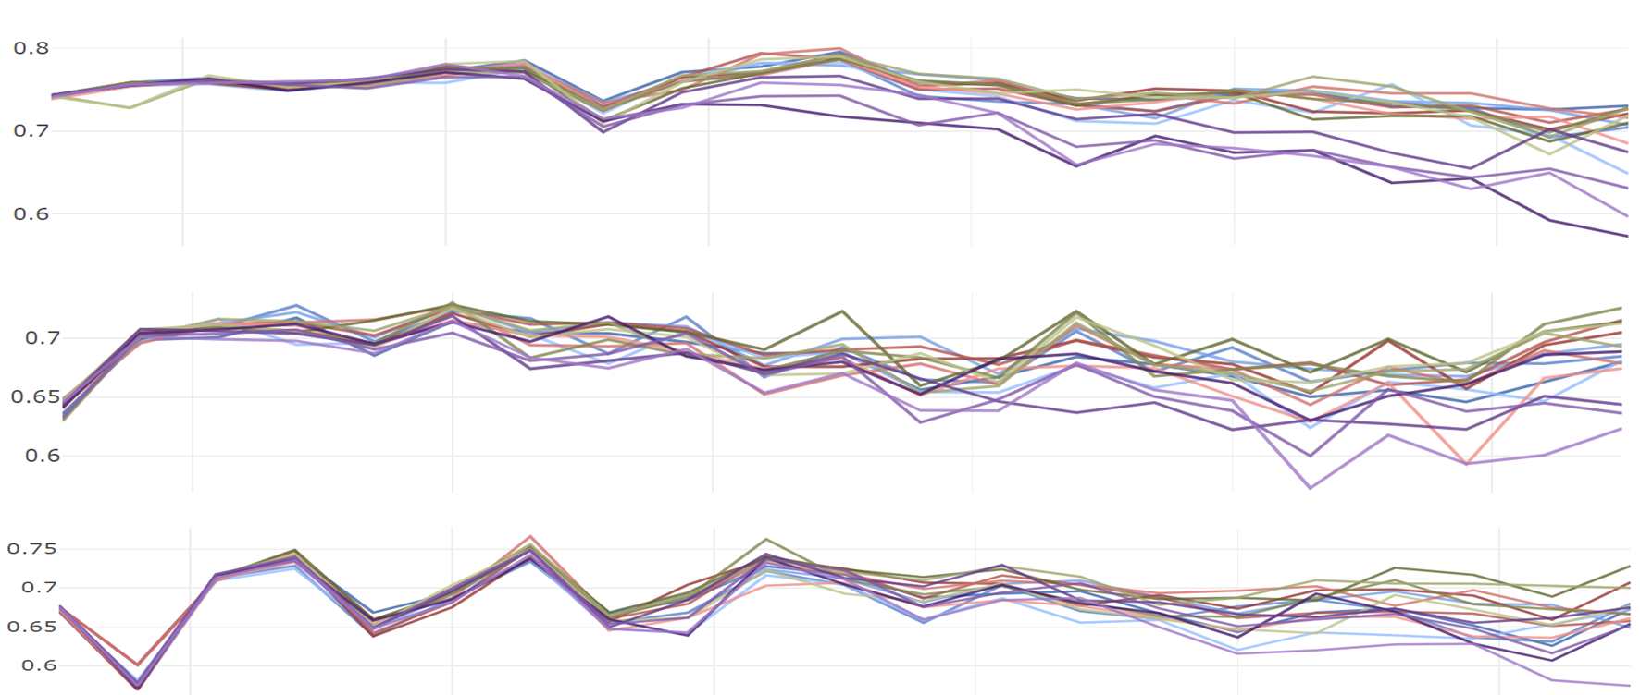
Simulated data 2 -Classification
Dataset 2
 | One Hot | Binary | Ordinal | Target | Sum | Purity | FI | RND | Sum | Purity | FI | RND | Sum | Purity | FI | RND | Sum | Purity | FI | RND
 | Traditional |  |  |  | Default |  |  |  | Correlation |  |  |  | PCA |  |  |  | RND
 | ～ | ～ | 3
Notes:
此為連續資料集二中不同方法的成績平均，依然可見RND排序方法於各群組方式中墊底
且Target encoding皆聚有不俗表現，因為其本身即屬於一種監度式的變數編碼方式
所以其分類成績皆優於其餘的變數編碼方式

Slide 67
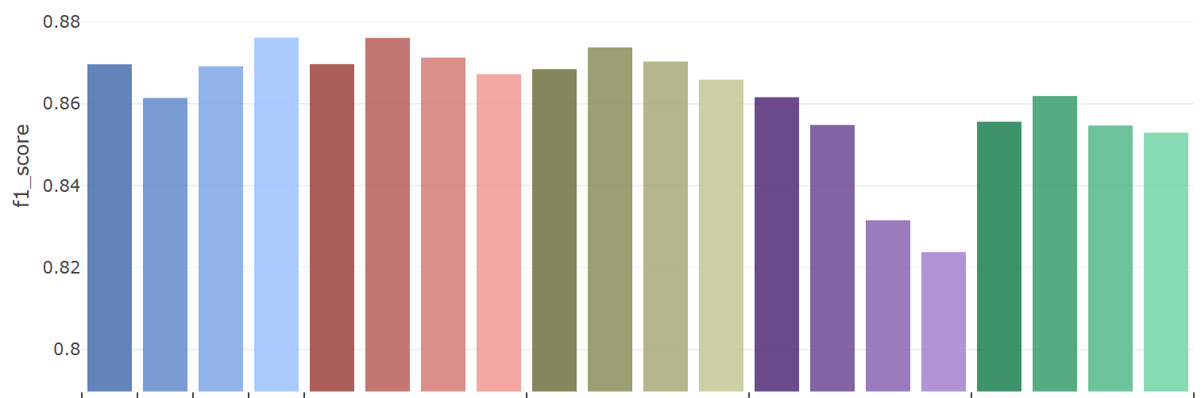
Simulated data 3 -Classification
Dataset 3
 | One Hot | Binary | Ordinal | Target | Sum | Purity | FI | RND | Sum | Purity | FI | RND | Sum | Purity | FI | RND | Sum | Purity | FI | RND
 | Traditional |  |  |  | Default |  |  |  | Correlation |  |  |  | PCA |  |  |  | RND
 | ～ | ～ | 3
Notes:
此為連續資料集三中不同方法的成績平均，
由原始連續圖形中可見，本資料集兩種類別區分容易，本身便易於區分
相較前兩個資料集有著較高的分類成績

Slide 68
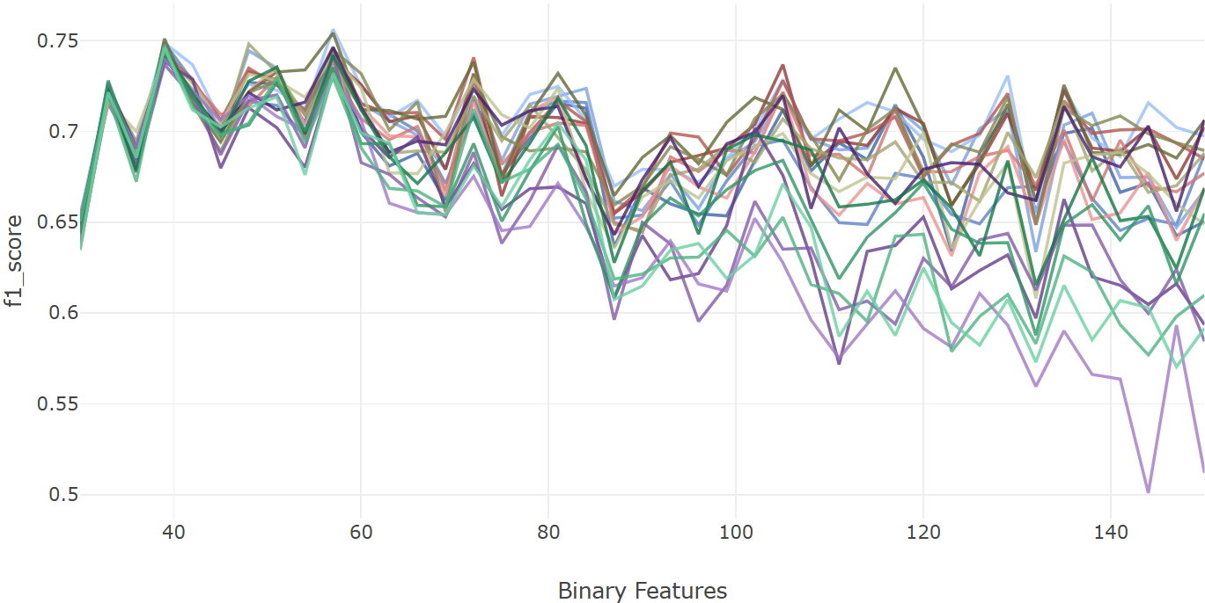
Simulated data 1 -Classification
Dataset 1
Traditional | OneHot
 | Ordinal
 | Binary
 | Target
Default | Sum
 | Purity
 | FI
 | RND
Correlation | Sum
 | Purity
 | FI
 | RND
PCA | Sum
 | Purity
 | FI
 | RND
RND | Sum
 | Purity
 | FI
 | RND
Notes:
在分類結果的評比中，與OneHot, Binary, Ordinal, 與Target encoding等4種傳統的變數編碼比較
以及本研究四種群組方式，分別是根據原先群組資訊、主成分分析、皮爾森相關係數與隨機群組
結合4種排序方式，分別是特徵總和、類別純粹度、特徵重要性、與隨機排列
並以LightGBM梯度提升決策樹作為分類模型，且f1 score作為數值資料衡量標準
此折線圖則顯示了在切分出不同的二元特徵之下，各種方法k-folds驗證後的平均f1 score變化

Slide 69
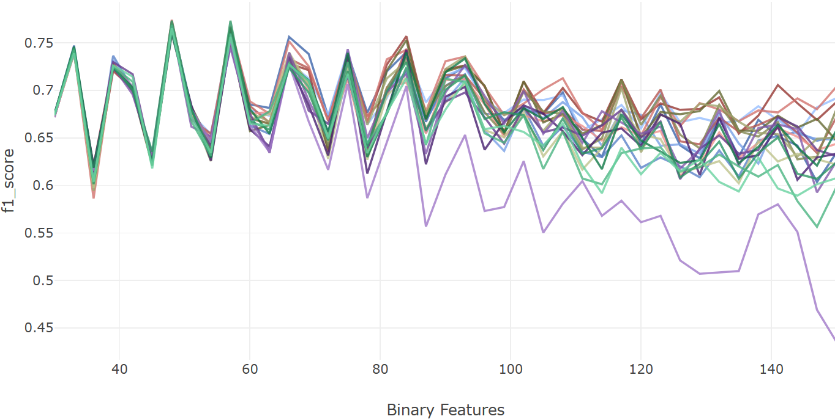
Simulated data 2 -Classification
Dataset 2
Traditional | OneHot
 | Ordinal
 | Binary
 | Target
Default | Sum
 | Purity
 | FI
 | RND
Correlation | Sum
 | Purity
 | FI
 | RND
PCA | Sum
 | Purity
 | FI
 | RND
RND | Sum
 | Purity
 | FI
 | RND
Notes:
此為連續資料集二於不同二元特徵個數下的分類成績折線

Slide 70
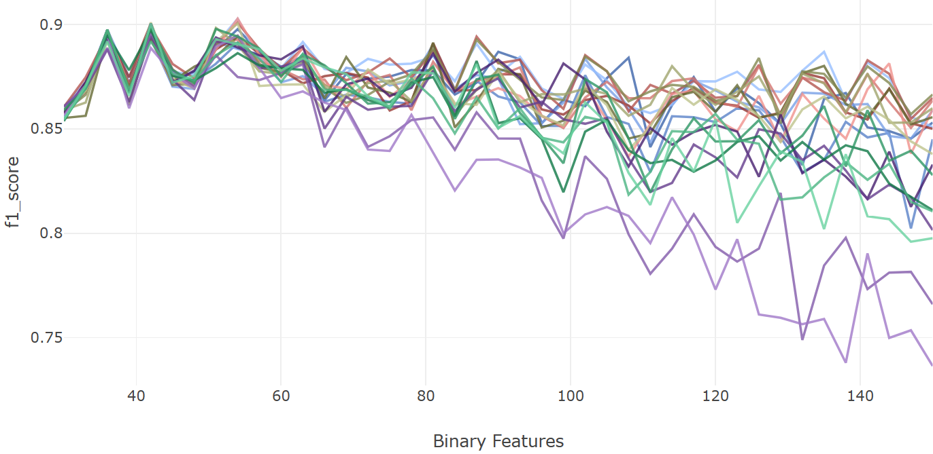
Simulated data 3 -Classification
Dataset 3
Traditional | OneHot
 | Ordinal
 | Binary
 | Target
Default | Sum
 | Purity
 | FI
 | RND
Correlation | Sum
 | Purity
 | FI
 | RND
PCA | Sum
 | Purity
 | FI
 | RND
RND | Sum
 | Purity
 | FI
 | RND
Notes:
此為連續資料集三於不同二元特徵個數下的分類成績折線，
觀察了先前的折線圖可見，在切分的二元變數數量較少時，所有變數編碼產生的數值資料有著相近的分類成績；
然而，隨著所切分的二元變數個數增加，變數編碼產生數值資料的分類成績之間的變異也逐漸增加、
且分類成績也有著緩步下降的趨勢，類似在維度災難發生時導致的模型成果下降。

Slide 71
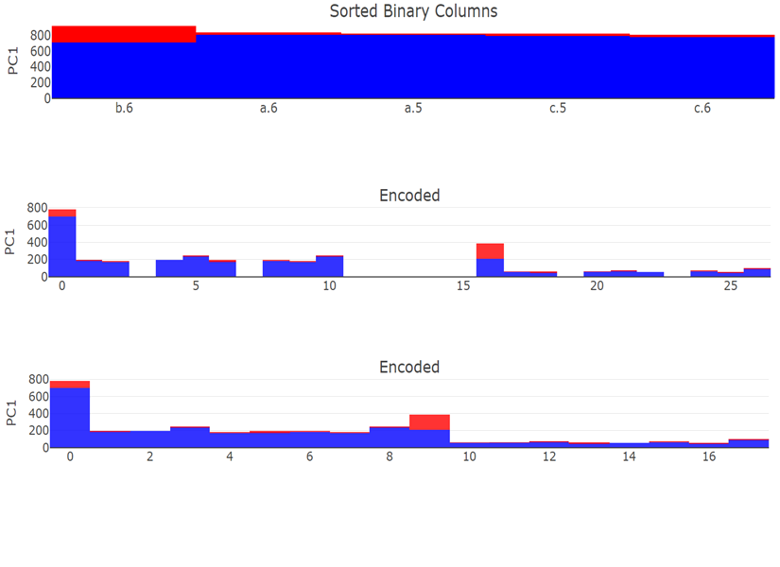
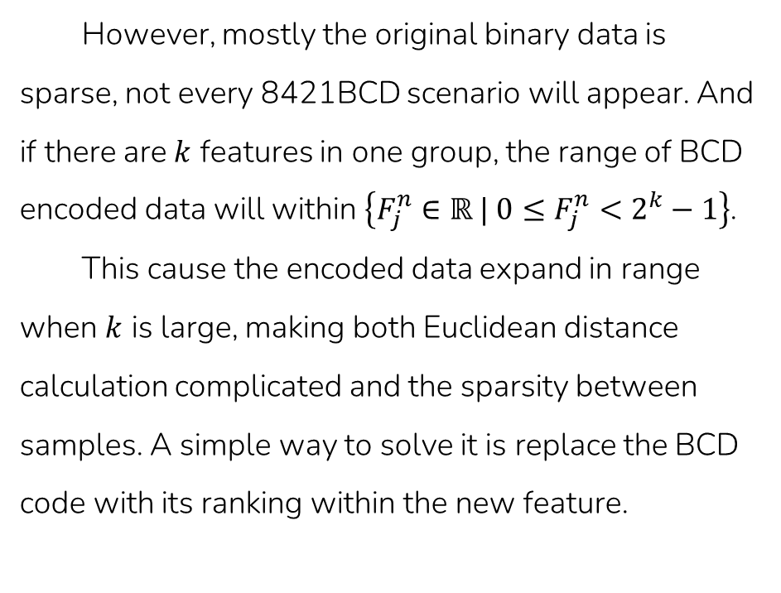
Methodology - BCD encode
However, mostly the original binary data is sparse, not every 8421BCD scenario will appear. And if there are $k$ features in one group, the range of BCD encoded data will within $\left\{F_{j}^{n}∈ℝ | 0≤F_{j}^{n}<2^{k}−1\right\}$.
This cause the encoded data expand in range when $k$ is large, making both Euclidean distance calculation complicated and the sparsity between samples. A simple way to solve it is replace the BCD code with its ranking within the new feature.
Sorted
BCD
Ranked
Notes:
別別別

Slide 72
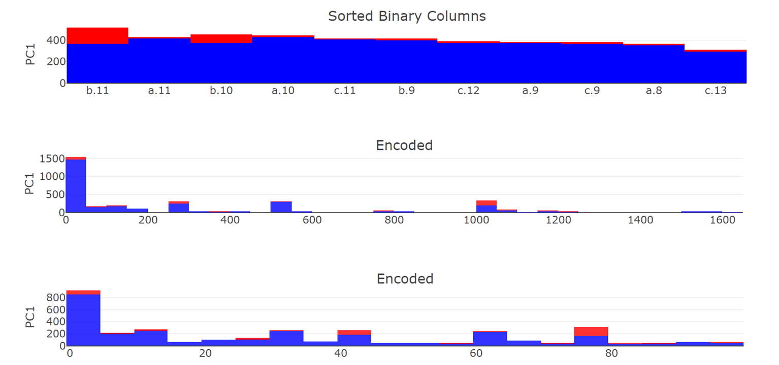
Methodology - BCD encode
Sorted
BCD
Ranked

Slide 73
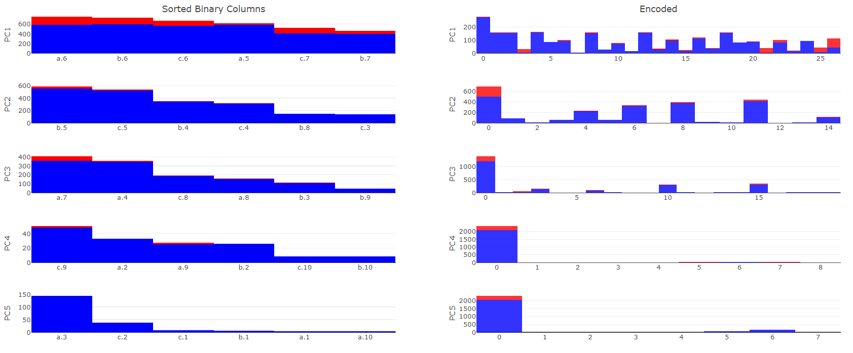
Simulated data - seq. by sum
Sequence by column sum | BCD
Notes:
These is a demonstration of PCA grouping before sequenced by column sum.
in each PC we can see columns from different axis, and also, compare PC1 to PC5, PC5 only has small size binary features. Meaning binary features in PC1 has more samples can explain more variance to the whole data.
The BCD result is reasonable too, the informative seems dwindling by PCs.

Slide 74


Simulated data - group by PCA
Binarize Data | Grouped by PCA

Slide 75

Continuous data - group by Corr.
Original Group | Grouped by Correlation

Slide 76

Simulated data - seq. by impurity
Sequence by impurity | BCD encoded

Slide 77


Simulated data - seq. comparison
 | Sequenced | BCD
Randomly
By Impurity

Slide 78
Animal |  |  |  |  |  |  |  | Size |  |  |  | Color
Tuna | Cat | Frog | Cod | Goat | Dog | Toad | Cow | Large | Mid | Small | Tiny | White | Black | Red | Blue | Green | Gray
0 | 0 | 0 | 0 | 0 | 0 | 0 | 1 | 1 | 0 | 0 | 0 | 1 | 0 | 0 | 0 | 0 | 0
1 | 0 | 0 | 0 | 0 | 0 | 0 | 0 | 0 | 1 | 0 | 0 | 0 | 1 | 0 | 0 | 0 | 0
⁝ | ⁝ | ⁝ | ⁝ | ⁝ | ⁝ | ⁝ | ⁝ | ⁝ | ⁝ | ⁝ | ⁝ | ⁝ | ⁝ | ⁝ | ⁝ | ⁝ | ⁝
0 | 0 | 1 | 0 | 0 | 0 | 0 | 1 | 0 | 0 | 0 | 1 | 0 | 0 | 0 | 0 | 1 | 0
No. | PC 1 |  |  | PC 2 |  |  | PC 3
 | Feature | Abs. weight | select | Feature | Abs. weight | select | Feature | Abs. weight | select
1. | Cow | 0.562 | O | Cat | 0.642 | X | Black | 0.047 | X
2. | Cat | 0.486 | O | Cow | 0.496 | X | Goat | 0.035 | X
3. | Large | 0.348 | O | Mid | 0.402 | X | Cat | 0.032 | X
4. | Mid | 0.311 | O | Black | 0.351 | X | Cow | 0.030 | X
5. | White | 0.307 | O | Goat | 0.302 | O | Mid | 0.028 | X
6. | Black | 0.202 | O | Dog | 0.229 | O | Gray | 0.023 | X
7. | Small | 0.187 | X | Large | 0.199 | X | White | 0.021 | X
8. | Goat | 0.153 | X | Frog | 0.183 | O | Dog | 0.020 | X
9. | Cod | 0.101 | X | Small | 0.152 | O | Large | 0.018 | X
10. | Tuna | 0.091 | X | Gray | 0.132 | O | Frog | 0.016 | X
11. | Dog | 0.074 | X | White | 0.105 | X | Small | 0.014 | X
12. | Gray | 0.060 | X | Red | 0.008 | O | Toad | 0.014 | O
13. | Frog | 0.056 | X | Frog | 0.008 | X | Tuna | 0.012 | O
14. | Toad | 0.032 | X | Red | 0.007 | X | Cod | 0.007 | O
15. | Red | 0.029 | X | Toad | 0.005 | X | Red | 0.005 | X
16. | Tiny | 0.023 | X | Green | 0.001 | X | Tiny | 0.002 | O
17. | Green | 0.015 | X | Tiny | 0.001 | X | Blue | 0.001 | O
18. | Blue | 0.009 | X | Blue | 0.001 | X | Green | 0.001 | O
PC 1 |  |  |  |  |  | PC 2 |  |  |  |  |  | PC 3
Cow | Cat | Large | Mid | White | Black | Goat | Dog | Frog | Small | Gray | Red | Toad | Tuna | Cod | Tiny | Blue | Green
1 | 0 | 1 | 0 | 1 | 0 | 0 | 0 | 0 | 0 | 0 | 0 | 0 | 0 | 0 | 0 | 0 | 0
0 | 0 | 0 | 1 | 0 | 1 | 0 | 0 | 0 | 0 | 0 | 0 | 0 | 1 | 0 | 0 | 0 | 0
⁝ | ⁝ | ⁝ | ⁝ | ⁝ | ⁝ | ⁝ | ⁝ | ⁝ | ⁝ | ⁝ | ⁝ | ⁝ | ⁝ | ⁝ | ⁝ | ⁝ | ⁝
1 | 0 | 0 | 0 | 0 | 0 | 0 | 0 | 1 | 0 | 0 | 0 | 0 | 0 | 0 | 1 | 0 | 1
Tuna | Cat | Frog | Cod | Goat | Dog | Toad | Cow | Large | Mid | Small | Tiny | White | Black | Red | Blue | Green | Gray
0 | 0 | 0 | 0 | 0 | 0 | 0 | 1 | 1 | 0 | 0 | 0 | 1 | 0 | 0 | 0 | 0 | 0
1 | 0 | 0 | 0 | 0 | 0 | 0 | 0 | 0 | 1 | 0 | 0 | 0 | 1 | 0 | 0 | 0 | 0
⁝ | ⁝ | ⁝ | ⁝ | ⁝ | ⁝ | ⁝ | ⁝ | ⁝ | ⁝ | ⁝ | ⁝ | ⁝ | ⁝ | ⁝ | ⁝ | ⁝ | ⁝
0 | 0 | 1 | 0 | 0 | 0 | 0 | 1 | 0 | 0 | 0 | 1 | 0 | 0 | 0 | 0 | 1 | 0

Slide 79
Corr 1 |  |  |  |  |  | Corr 2 |  |  |  |  |  | Corr 3
Cow | Cat | Large | Mid | White | Black | Goat | Dog | Frog | Small | Gray | Red | Toad | Tuna | Cod | Tiny | Blue | Green
1 | 0 | 1 | 0 | 1 | 0 | 0 | 0 | 0 | 0 | 0 | 0 | 0 | 0 | 0 | 0 | 0 | 0
0 | 0 | 0 | 1 | 0 | 1 | 0 | 0 | 0 | 0 | 0 | 0 | 0 | 1 | 0 | 0 | 0 | 0
⁝ | ⁝ | ⁝ | ⁝ | ⁝ | ⁝ | ⁝ | ⁝ | ⁝ | ⁝ | ⁝ | ⁝ | ⁝ | ⁝ | ⁝ | ⁝ | ⁝ | ⁝
1 | 0 | 0 | 0 | 0 | 0 | 0 | 0 | 1 | 0 | 0 | 0 | 0 | 0 | 0 | 1 | 0 | 1
 | Tuna | Cat | Frog | Cod | Goat | Dog | Toad | Cow | Large | Mid | Small | Tiny | White | Black | Red | Blue | Green | Gray
Tuna | 1.0 | 0.2 | 0.2 | 0.8 | 0.2 | 0.2 | 0.8 | 0.2 | 0.1 | 0.1 | 0.1 | 0.3 | 0.0 | 0.0 | 0.0 | 0.5 | 0.5 | 0.0
Cat | 0.2 | 1.0 | 0.2 | 0.2 | 0.2 | 0.2 | 0.2 | 0.8 | 0.3 | 0.3 | 0.1 | 0.1 | 0.2 | 0.2 | 0.0 | 0.0 | 0.0 | 0.0
Frog | 0.2 | 0.2 | 1.0 | 0.2 | 0.8 | 0.8 | 0.2 | 0.2 | 0.1 | 0.1 | 0.3 | 0.1 | 0.0 | 0.0 | 0.3 | 0.0 | 0.0 | 0.3
Cod | 0.8 | 0.2 | 0.2 | 1.0 | 0.2 | 0.2 | 0.8 | 0.8 | 0.1 | 0.1 | 0.1 | 0.3 | 0.0 | 0.0 | 0.0 | 0.3 | 0.3 | 0.0
Goat | 0.2 | 0.2 | 0.8 | 0.2 | 1.0 | 0.8 | 0.2 | 0.2 | 0.1 | 0.1 | 0.3 | 0.1 | 0.0 | 0.0 | 0.3 | 0.0 | 0.0 | 0.3
Dog | 0.2 | 0.2 | 0.8 | 0.2 | 0.8 | 1.0 | 0.2 | 0.2 | 0.1 | 0.1 | 0.3 | 0.1 | 0.0 | 0.0 | 0.3 | 0.0 | 0.0 | 0.3
Toad | 0.8 | 0.2 | 0.2 | 0.8 | 0.2 | 0.2 | 1.0 | 0.2 | 0.1 | 0.1 | 0.1 | 0.3 | 0.0 | 0.0 | 0.0 | 0.3 | 0.0 | 0.0
Cow | 0.2 | 0.8 | 0.2 | 0.8 | 0.2 | 0.2 | 0.2 | 1.0 | 0.3 | 0.3 | 0.1 | 0.1 | 0.3 | 0.3 | 0.0 | 0.0 | 0.0 | 0.0
Large | 0.1 | 0.3 | 0.1 | 0.1 | 0.1 | 0.1 | 0.1 | 0.3 | 1.0 | 0.5 | 0.1 | 0.1 | 0.6 | 0.6 | 0.2 | 0.2 | 0.2 | 0.2
Mid | 0.1 | 0.3 | 0.1 | 0.1 | 0.1 | 0.1 | 0.1 | 0.3 | 0.5 | 1.0 | 0.1 | 0.1 | 0.6 | 0.6 | 0.2 | 0.2 | 0.2 | 0.2
Small | 0.1 | 0.1 | 0.3 | 0.1 | 0.3 | 0.3 | 0.1 | 0.1 | 0.1 | 0.1 | 1.0 | 0.1 | 0.2 | 0.2 | 0.6 | 0.2 | 0.2 | 0.6
Tiny | 0.3 | 0.1 | 0.1 | 0.3 | 0.1 | 0.1 | 0.3 | 0.1 | 0.1 | 0.1 | 0.1 | 1.0 | 0.2 | 0.2 | 0.2 | 0.6 | 0.2 | 0.2
White | 0.0 | 0.2 | 0.0 | 0.0 | 0.0 | 0.0 | 0.0 | 0.3 | 0.6 | 0.6 | 0.2 | 0.2 | 1.0 | 0.8 | 0.4 | 0.4 | 0.4 | 0.4
Black | 0.0 | 0.2 | 0.0 | 0.0 | 0.0 | 0.0 | 0.0 | 0.3 | 0.6 | 0.6 | 0.2 | 0.2 | 0.8 | 1.0 | 0.4 | 0.4 | 0.4 | 0.8
Red | 0.0 | 0.0 | 0.3 | 0.0 | 0.3 | 0.3 | 0.0 | 0.0 | 0.2 | 0.2 | 0.6 | 0.2 | 0.4 | 0.4 | 1.0 | 0.4 | 0.4 | 0.4
Blue | 0.5 | 0.0 | 0.0 | 0.3 | 0.0 | 0.0 | 0.3 | 0.0 | 0.2 | 0.2 | 0.2 | 0.6 | 0.4 | 0.4 | 0.4 | 1.0 | 0.8 | 0.8
Green | 0.5 | 0.0 | 0.0 | 0.3 | 0.0 | 0.0 | 0.0 | 0.0 | 0.2 | 0.2 | 0.2 | 0.2 | 0.4 | 0.4 | 0.4 | 0.8 | 1.0 | 0.4
Gray | 0.0 | 0.0 | 0.3 | 0.0 | 0.3 | 0.3 | 0.0 | 0.0 | 0.2 | 0.2 | 0.6 | 0.2 | 0.4 | 0.8 | 0.4 | 0.8 | 0.4 | 1.0
 | Cow | Cat | Large | Mid | White | Black | Goat | Dog | Frog | Small | Gray | Red | Toad | Tuna | Cod | Tiny | Blue | Green
Cow | 1.0 | 0.8 | 0.3 | 0.3 | 0.5 | 0.5 | 0.2 | 0.2 | 0.2 | 0.1 | 0.0 | 0.0 | 0.2 | 0.2 | 0.2 | 0.1 | 0.0 | 0.0
Cat | 0.8 | 1.0 | 0.3 | 0.3 | 0.5 | 0.5 | 0.2 | 0.2 | 0.2 | 0.1 | 0.0 | 0.0 | 0.2 | 0.2 | 0.2 | 0.1 | 0.0 | 0.0
Large | 0.3 | 0.3 | 1.0 | 0.5 | 0.6 | 0.6 | 0.1 | 0.1 | 0.1 | 0.1 | 0.2 | 0.2 | 0.1 | 0.1 | 0.1 | 0.1 | 0.2 | 0.2
Mid | 0.3 | 0.3 | 0.5 | 1.0 | 0.6 | 0.6 | 0.1 | 0.1 | 0.1 | 0.1 | 0.2 | 0.2 | 0.1 | 0.1 | 0.1 | 0.1 | 0.2 | 0.2
White | 0.5 | 0.5 | 0.6 | 0.6 | 1.0 | 0.8 | 0.0 | 0.0 | 0.0 | 0.2 | 0.4 | 0.4 | 0.0 | 0.0 | 0.0 | 0.2 | 0.4 | 0.4
Black | 0.5 | 0.5 | 0.6 | 0.6 | 0.8 | 1.0 | 0.0 | 0.0 | 0.0 | 0.2 | 0.4 | 0.4 | 0.0 | 0.0 | 0.0 | 0.2 | 0.4 | 0.4
Goat | 0.2 | 0.2 | 0.1 | 0.1 | 0.0 | 0.0 | 1.0 | 0.8 | 0.8 | 0.3 | 0.3 | 0.3 | 0.2 | 0.2 | 0.2 | 0.1 | 0.0 | 0.0
Dog | 0.2 | 0.2 | 0.1 | 0.1 | 0.0 | 0.0 | 0.8 | 1.0 | 0.8 | 0.3 | 0.5 | 0.5 | 0.2 | 0.2 | 0.2 | 0.1 | 0.0 | 0.0
Frog | 0.2 | 0.2 | 0.1 | 0.1 | 0.0 | 0.0 | 0.8 | 0.8 | 1.0 | 0.3 | 0.5 | 0.5 | 0.2 | 0.2 | 0.2 | 0.1 | 0.0 | 0.0
Small | 0.1 | 0.1 | 0.1 | 0.1 | 0.2 | 0.2 | 0.3 | 0.3 | 0.3 | 1.0 | 0.6 | 0.6 | 0.1 | 0.1 | 0.1 | 0.1 | 0.2 | 0.2
Gray | 0.0 | 0.0 | 0.2 | 0.2 | 0.4 | 0.4 | 0.3 | 0.5 | 0.5 | 0.6 | 1.0 | 0.8 | 0.0 | 0.0 | 0.0 | 0.2 | 0.4 | 0.4
Red | 0.0 | 0.0 | 0.2 | 0.2 | 0.4 | 0.4 | 0.3 | 0.5 | 0.5 | 0.6 | 0.8 | 1.0 | 0.0 | 0.0 | 0.0 | 0.2 | 0.4 | 0.4
Toad | 0.2 | 0.2 | 0.1 | 0.1 | 0.0 | 0.0 | 0.2 | 0.2 | 0.2 | 0.1 | 0.0 | 0.0 | 1.0 | 0.8 | 0.8 | 0.3 | 0.5 | 0.5
Tuna | 0.2 | 0.2 | 0.1 | 0.1 | 0.0 | 0.0 | 0.2 | 0.2 | 0.2 | 0.1 | 0.0 | 0.0 | 0.8 | 1.0 | 0.8 | 0.3 | 0.5 | 0.5
Cod | 0.2 | 0.2 | 0.1 | 0.1 | 0.0 | 0.0 | 0.2 | 0.2 | 0.2 | 0.1 | 0.0 | 0.0 | 0.8 | 0.8 | 1.0 | 0.3 | 0.5 | 0.5
Tiny | 0.1 | 0.1 | 0.1 | 0.1 | 0.2 | 0.2 | 0.1 | 0.1 | 0.1 | 0.1 | 0.2 | 0.2 | 0.3 | 0.3 | 0.3 | 1.0 | 0.6 | 0.6
Blue | 0.0 | 0.0 | 0.2 | 0.2 | 0.4 | 0.4 | 0.0 | 0.0 | 0.0 | 0.2 | 0.4 | 0.4 | 0.5 | 0.5 | 0.5 | 0.6 | 1.0 | 0.8
Green | 0.0 | 0.0 | 0.2 | 0.2 | 0.4 | 0.4 | 0.0 | 0.0 | 0.0 | 0.2 | 0.4 | 0.4 | 0.5 | 0.5 | 0.5 | 0.6 | 0.8 | 1.0

Slide 83


Slide 84
 | Sequenced Column Group |  |  |  |  |  | BCD | Type
 | Blue | Tuna | Tiny | Toad | Green | Cod
Sample 1 | 1 | 0 | 0 | 0 | 0 | 1 | 33 | Good
Sample 2 | 1 | 0 | 0 | 1 | 0 | 0 | 36 | Good
Sample 3 | 0 | 0 | 1 | 0 | 1 | 0 | 10 | Bad
Sample 4 | 0 | 0 | 1 | 1 | 1 | 0 | 14 | Bad
⁝ | ⁝ | ⁝ | ⁝ | ⁝ | ⁝ | ⁝ | ⁝ | ⁝

Slide 85



Instances | X | Y | Z
1 | x.2 | y.9 | z.4
2 | x.1 | y.8 | z.2
3 | x.9 | y.1 | z.6
4 | x.5 | y.7 | z.8
5 | x.3 | y.1 | z.8
6 | x.5 | y.6 | z.3
7 | x.7 | y.5 | z.4
⁝ | ⁝ | ⁝ | ⁝
3300 | x.4 | y.8 | z.1
Instances | x.1 | x.2 | x.3 | x.4 | x.5 | x.6 | … | z.9 | z.10
1 | 0 | 1 | 0 | 0 | 0 | 0 | … | 0 | 0
2 | 1 | 0 | 0 | 0 | 0 | 0 | … | 0 | 0
3 | 0 | 0 | 0 | 0 | 0 | 0 | … | 0 | 0
4 | 0 | 0 | 0 | 0 | 1 | 0 | … | 0 | 0
5 | 0 | 0 | 1 | 0 | 0 | 0 | … | 0 | 0
6 | 0 | 0 | 0 | 0 | 1 | 0 | … | 0 | 0
7 | 0 | 0 | 0 | 0 | 0 | 0 | … | 0 | 0
⁝ | ⁝ | ⁝ | ⁝ | ⁝ | ⁝ | ⁝ | ⁝ | ⁝ | ⁝
3300 | 0 | 0 | 0 | 1 | 0 | 0 | … | 0 | 0

Slide 86



Traditional | OneHot
 | Ordinal
 | Binary
 | Target
Default | Sum
 | Purity
 | FI
 | RND
Correlation | Sum
 | Purity
 | FI
 | RND
PCA | Sum
 | Purity
 | FI
 | RND
RND | Sum
 | Purity
 | FI
 | RND
 | One Hot | Binary | Ordinal | Target | Purity | Purity
 | Traditional |  |  |  | Default | PCA
 | 83 | 38 | 17 |  |  | 10 | 20 | 30
 | One Hot | Binary | Ordinal | Target | Sum | Purity | FI | RND | Sum | Purity | FI | RND | Sum | Purity | FI | RND | Sum | Purity | FI | RND
 | Traditional |  |  |  | Default |  |  |  | Correlation |  |  |  | PCA |  |  |  | RND
 | 21 | 15 | 6

Slide 87




Slide 88



By purity |  | Randomly
1 | Cluster | 24

Slide 89



Difference 3D Dimension Reduced Data After Encode With Certain Sequencing
Impurity | Randomly | Sum

Slide 90



 | Purity | Purity | Purity | Purity | Purity
 | PCA
 | 10 | 20 | 30 | 40 | 50
 | Purity | Purity | Purity | Purity | Purity
 | Corr
 | 10 | 20 | 30 | 40 | 50

Slide 91



